Slide 1
„Viele von uns haben jetzt zwei Heimaten“
https://www.zeit.de/gesellschaft/2025-11/syrien-gefluechtete-migration-schutzstatus-abschiebung

Slide 2
The International Organization for Migration (IOM) defines ‘migrant’ as:
any person who is moving or has moved across an international border or within a state away from his/her habitual place of residence, regardless of (1) the person’s legal status; (2) whether the movement is voluntary or involuntary; (3) what the causes for the movement are; or (4) what the length of the stay is.¹
By contrast, ‘immigration’ is defined as ‘a process by which non-nationals move into a country for the purpose of settlement’ (IOM 2017) while the term ‘migration’ points to the ongoing dynamics of a process that does not end after settlement. In addition, the United Nations High Commissioner for Refugees (UNHCR) supports a terminological distinction between migrants and refugees:
Migrants choose to move not because of a direct threat of persecution or death, but mainly to improve their lives by finding work, or in some cases for education, family reunion, or other reasons. Unlike refugees who cannot safely return home, migrants face no such impediment to return. If they choose to return home, they will continue to receive the protection of their government.²
The definition of the Council of Europe: migrant refers, “depending on the context, to emigrants, returning migrants, immigrants, refugees, displaced persons and persons of immigrant background and/or members of ethnic minority populations that have been created through immigration”.³

Slide 3
In 2023, 23,8 million migrants or people with a so-called migration background lived in Germany, or 28,7 per cent of the country’s population of 82 million.
(This includes individuals who immigrated to Germany themselves or those with at least one parent who was not a German citizen at birth)
Every forth person living in Germany has parents or grandparents who came from another country. Among those under 18, it is 37 percent.
In big cities like Hamburg, it is every third inhabitant and 46 percent of underage persons. In Frankfurt it is every second inhabitant, almost 70 percent of school children.
A cultural, ethnic, religious and national diversity shapes German society. Plurality and heterogeneity form the everyday experience of many residents in Germany, although not all of them manage this new reality in the same way.
Uneven distribution of immigrants and their descendants: approximately 95 per cent of them live in West Germany, and approximately 5 per cent in the East.
Naika Foroutan, the Post-Migrant society, 2019, a new concept

Slide 4
Post migrant society
https://sharingperspectivesfoundation.com/video-lecture/video-21/Naika Foroutan
https://www.dw.com/de/woher-kommst-du-vonhier/a-47988141

Slide 5
Not a question whether Germany is an immigration country, but how this is negociated.
The prefix ‘post’ in post-migrant contains a twofold objective, as it tries to reflect the ambivalent simultaneity of migration in society: while migration is ongoing and a global phenomenon of mobility, the arrival of migrants remains contested on the basis of ethnic, cultural, religious or national backgrounds.
On the one hand, migration is a demographic normality, but on the other, this demographic normality is turned into an anomaly by ‘migrantizing’ one part of society, which entails exclusion from a country’s shared identity.
The ‘post’ thus reflects a period and situation that follows after migration has occurred, but during which migration-based exclusion remains a common experience. The concept exposes the dominant continuity of the migration narrative as a basis for social division, while at the same time seeking to challenge and go beyond this divide.

Slide 6
Post-migrant societies contain five main key processes of interaction that can be analysed by social scientists:
(1) political or legal acceptance, and recognition of being a country of immigration;
(2) negotiations of rights, positions and representations for minority groups;
(3) ambivalences and ambiguities on national identity concepts and concepts of belonging;
(4) alliances based on ideological positioning on diversity and migration;
(5) antagonism and radicalization against those that embrace diversity.
The empirical-analytical approach examines and focuses on the empirically existent and observable inequalities, transformations and developments, and analyses their consolidation on institutional, structural, sociopolitical and legal levels. It analyses attitudes and reactions within and towards a pluralizing society with regard to migration policy issues on symbolic and material belongings.
The critical-dialectical approach further embeds the empirical-analytical findings in prevailing social conditions and already established power structures. Empirical findings and observations further examine social inequalities in post-migrant societies and pose the following question: to what extent is it about securing privileges, maintaining positions of power and a socially established status?

Slide 7
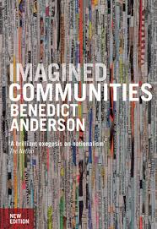
Benedict Anderson argues that the newspaper plays a crucial role in forming national identity and consciousness. He describes the consumption of newspapers as a "mass ceremony" that creates a sense of shared, anonymous communion among people who will never meet.

Slide 8
Forces driving migration
Push-and-Pull factors
Push factors:
poverty, armed conflict, violence, social strife, political turmoil, prosecution, economic hardships, environmental degradation, absence of jobs/prospects, unemployment/low wages,
inequality, discrimination, corruption, human rights abuses, problems of governance and rule of law, lack of freedoms, increasing disparities between developing and developed nations; international economic disparities
Third world to first world, usually, but not only.
Pull factors
- safety, stability, freedom, job prospects, higher wages, better environment, friends and family

Slide 9
Forces driving migration: policy-decisions in receiver countries
- Policy decisions in receiver countries shape immigration patterns (e.g. economic, labor market structures, required skill profiles, forms of migrant recruitments, visa requirements, demographic
trends)
- immigration policies (policies that seek to regulate entry to territory)
-immigrant policies (“integrate” migrant newcomers)
- Changes in migration policy facilitate entry of particular groups of origin
- while simultaneously restricting entry of other groups
(patterns of migration selectivity by age, gender, education/skill levels,
ethnic roots, country of origin, etc.).

Slide 10
Migrant integration
Transnationalism
Diaspora-building

Slide 11
Integration
Berry´s (1992) four adaptation-strategies
assimilation (strong identification with the host culture, weak or no identification with the culture of origin),
integration (strong identification with both host and origin cultures),
separation (weak identification with the host culture, strong identification with the culture of origin)
marginalization (strong detachment from both host and origin cultures)

Slide 12
The transnationalism paradigm
(see Schiller, Basch, and Blanc 1995; Smith and Guarnizo 1998; Halm and Thränhardt 2009; Portes 2001).
how people divide their life and its meaning between several societies and how they travel more frequently, often holding two passports and even voting in more than one country (also working patterns)
Cheaper travelling, cheaper and quicker communication (not new but faster than letters), internet.
And its critics. Limits of transnationalism. Cannot always be added. Migration as a transformative experience, conflict-sensitive etc. Waldinger and Green (2016), Green (2019).
Waldinger (2017: 141) states that ‘holding onto earlier identities and cultures is perfectly acceptable as long as these are additions to a fundamentally American core’; in other words, some differences are acceptable while others are not.

Slide 13
Diaspora building
Vertovec distinguishes three different meanings of the term diaspora (as a social form, as a type of consciousness and as a mode of cultural production), and he defines a diaspora as “practically any population which is considered ‘deterritorialised’ or ‘transnational’ – that is, whose cultural origins are said to have arisen in a land other than that in which they currently reside, and whose social, economic and political networks cross borders of nation-states or, indeed, span the globe” (Vertovec, 2000: 141).

Slide 14
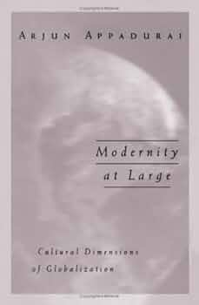
Arjun Appadurai (1996) – Modernity at large
Turkish guest-workers in Germany watching films from their country of origin in their German apartments;
South Koreans in Philadelphia watching the 1988 Olympics in Seoul through satellite-TV feeds from South Korea,
Pakistani taxi-drivers in Chicago listening to tapes of sermons recorded in mosques in Iran.
Deterritorialized identities

Slide 15
Ulrich Beck (2002) The Cosmopolitan Society and its Ennemies
Ulrich Beck was one of the most influential sociologists of recent decades. Concepts he developed – including risk society, individualization, cosmopolitanization, subpolitics and the democratization of science – are among the most cited, used and contested in contemporary sociology.
He proposed that a momentous shift to a new modernity has begun and challenged sociologists as to whether the concepts they use are up to the task of tracing this emerging dynamic. Provocative, Beck asked whether concepts like the nation state, family and class are functioning as ‘zombie categories’, continuing on in sociology but no longer relevant to social experience.

Slide 16
Against „methodological nationalism“, in favor of methodogical „cosmospolitanism“
Beck holds the view that it is necessary to abandon nation-state-centered analysis and embrace “methodological cosmopolitanism”. His argument is that of better understanding our reality.
If, for instance, German-Turkish migrants living in Berlin are analyzed on only one national frame or reference, they might be wrongly perceived in a rather one-dimensional view as uprooted, disintegrated, or homeless. They are therefore stripped of their more complex identity and denied their “both/and” (Beck, 2006: 7) character.
Hybrid identities
Multiple belongings
Post-migrant societies (being a migrant only part of what defines us)

Slide 17
(Can Duendar, in DiE ZEIT, 31.1.24) 12 Mio migrants live in Germany with a foreign citizenship. Half of them don‘t have a German passport, although they have already been there for longer than ten years. The head of the Turkish Community Germany, Gökay Sofuoğlu, estimates that all 1,5 Millionen Turkish citizens who have been so far without a German passport will acquire also German citizenship in the long run.

Slide 18
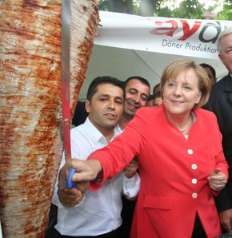
Food and migration

Slide 19
End

Slide 20
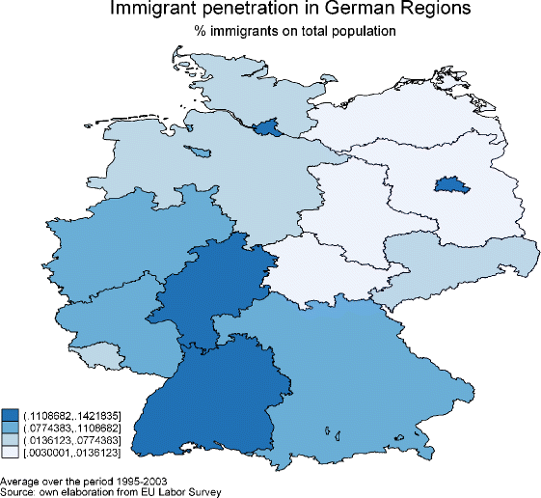

Slide 21
Jan-Philip Steinmann (2019) The paradox of integration: why do higher educated new immigrants perceive more discrimination in Germany?, Journal of Ethnic and Migration Studies,
Counterintuitive findings in the Netherland, does this also apply to Polish and Turkish immigrants in Germany?
The study complements existing research in three ways, by focusing on a new country, distinguishing between ethnic groups, and examining recent migrants.

Slide 22
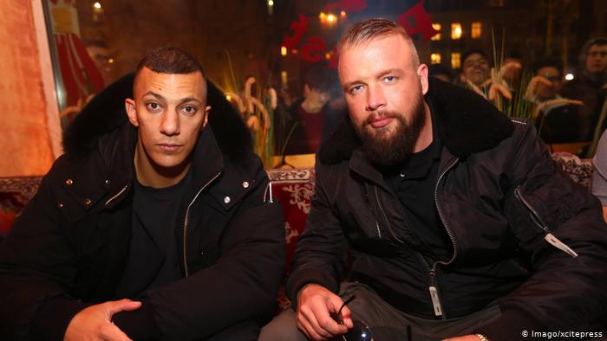
Farid Bang and Kollegah - Echo Prize 2018

Slide 23
Anti-Israel Twitter controversy
In January 2013, Bushido garnered additional media attention by tweeting "Free Palestine" along with a map of the Middle East without Israel.
Israel's embassy in Berlin responded to the rapper's actions by tweeting, with irony, directly to his Twitter handle: "@Bushido78 first women, then gays and now Israel: We are proud to belong to the victims of the integration prize winner Bushido."
In 2011, Bushido received a Bambi Award for successful German integration in Germany – despite his reputation for homophobia and misogyny. The Bambi Foundation head Patricia Riekel reacted to his tweet by saying: "We are examining the incident and will react accordingly."

