Slide 1

Freedom of Religion
or Freedom from Religion?
Who has to adjust to whom?
German Courts, Islamic Norms, and School Participation
University Course: Migration(s) to Germany: Policies, Perceptions and Realities
Primary Source: Spengler, F. (2019). Islam and Christian–Muslim Relations, 30(3), 363-382.
Secondary Source: Koopmans, R. (2013). Annual Review of Sociology, 39, 147-169.

Slide 2

The Central Tension
Three Constitutional Rights in Conflict
Religious Freedom (Art. 4): Right to practice faith, freedom from coercion
Parental Right (Art. 6): Freedom to raise children according to beliefs
State's Educational Right (Art. 7): Duty to integrate children and organize curriculum
Spengler (2019), pp. 363-370. German Constitutional Framework

Slide 3
Swimming, School Trips, Sex Education: 36 Cases (1972-2016)
Muslim Cases: 21 total
Christian Cases: 15 total
Swimming: 15 cases
Swimming: 2 cases
School trips: 3 cases
School trips: 3 cases
Sex education: 3 cases
Sex education: 10 cases
Source: Spengler (2019), p. 363. Analysis of dejure.org judicial database, 1972-2016.

Slide 4
Swimming Lessons: The Shift
1986
Berlin Girl (First Muslim Case)
✓ Exemption GRANTED
1993
Federal Admin Court
✓ Exemption GRANTED (PE & swimming)
2013
Frankfurt Burkini Case
✗ Exemption DENIED (burkini solution)
2016
Federal Constitutional Court
✗ Exemption DENIED (final)
Source: Spengler (2019), pp. 364-368. News: BBC, DW, NBC, Reuters (2013); The Independent, The Local (2016).

Slide 5
Islamic Modesty Framework
ʿAwra: Parts of body that must be concealed (women: all except face/hands from men)
Fitna: Concept of sexual temptation driving modest dress requirements
Quranic basis: Women should not reveal navel-to-knee region to anyone; both genders follow this rule
Consensus: Most Islamic jurists agree on these standards across schools of law
"Religious norms don't always match cultural practice—but perception matters for families." – Spengler (2019)
Source: Spengler (2019), pp. 365-366. Analysis of Islamic legal schools.

Slide 6
The Burkini: Compromise or Capitulation?
Invention & Adoption
Invented 2004 by Aheda al-Zanetti (Lebanese-Australian)
Full-body coverage: face, hands, feet exposed only
Allows participation while maintaining ʿawra
Courts' Logic (2013): Girl covers own ʿawra; only exposed to others' ʿawra. Problem mitigated.
Islamic Objection: Jurists reject—women shouldn't be in physically charged environments with men regardless of dress.
Source: Spengler (2019), pp. 367-368. DW (2013): https://www.dw.com/en/burkini-swimsuit-is-compromise-says-german-court/a-17083545

Slide 7
School Trips: The Mahram Problem
"Kamel-Fatwa" (1998)
Girls cannot travel overnight without mahram (male guardian). Distance: ~81 km (camel's daily journey)
Court Responses
2002: Initially sympathetic—brother could accompany as mahram
2013: Rejected mahram requirement as contradicting gender equality
Media mockery: "camel-jockey" fatwa increased resistance
Source: Spengler (2019), pp. 369-370. Fatwa issued by Amir Zaidan, 1998.

Slide 8
Sex Education: Curriculum Expansion
Islamic Position: Sex education acceptable, but content conflicts: premarital sex forbidden, contraception avoided, masturbation prohibited, homosexuality rejected.
Source: Spengler (2019), pp. 371-373. Curriculum evolution across Länder.

Slide 9
Sex Education Court Cases
1972
Hamburg Christian Family
✓ Exemption GRANTED → Curriculum reform
1992 & 1997
Berlin Muslim Families
✓ Exemptions GRANTED (temporary)
2004+
Hamburg Muslim Girl & Others
✗ All exemptions DENIED
Source: Spengler (2019), pp. 371-375. Federal Constitutional Court 1972 ruling shaped subsequent jurisprudence.

Slide 10
The Transformation: Why Did Courts Change?
1986-1997: Courts balance rights; tolerate accommodation
Late 1990s: Public discourse shifts; media scrutiny intensifies
2000s: Integration becomes dominant policy
2010s: Courts firmly deny exemptions
Key: Constitutional law didn't change. Society's "secular consensus" did. Religious claims became less sympathetic.
Source: Spengler (2019), pp. 376-378. Judicial reasoning analysis, 1972-2016.

Slide 11
Why the Shift? Context Matters
1998
Political Turning Point
SPD & Greens gain power. Germany officially becomes "country of immigration."
2000-2005
Media Explosion
Articles in Der Stern & Der Spiegel: 15 (1973-1997) → 104 (1998-2016)
2005+
Political Hardening
Even left-wing parties adopt integration policies. "Multikulti" declared failed (Merkel, 2010).
Source: Spengler (2019), pp. 376-378. Media analysis from Der Spiegel & Der Stern archives.

Slide 12
How Media Shaped the Debate
"German judges paved the way to parallel societies for Islamic fundamentalists"
— Der Spiegel (2007)
Narrative Framework:
Courts too accommodating of "parallel societies"
Integration incompatible with religious accommodation
Exemptions portrayed as threats to gender equality
Religious claims reframed as "refusals to integrate"
Source: Spengler (2019), p. 376. Der Spiegel (2007): https://www.spiegel.de/international/germany/german-justice-failures-paving-the-way-for-a-muslim-parallel-society-a-474629.html

Slide 13
Reality Check: How Many Families Seek Exemptions?
Bottom line: 21 court cases over 44 years. Problem tiny but symbolically huge. Most Muslim families see no contradiction.
Source: Haug, S., Müssig, S., & Stichs, A. (2009). Cited in Spengler (2019), p. 364.

Slide 14
Not Just Muslims: Christian Cases (15 total)
1986 Munich: Palmarian Church girls → Exemption GRANTED
1972 Hamburg: Christian family sex ed → Exemption GRANTED + curriculum reform
1993 Federal Admin: Christian girl swimming/PE → Exemption DENIED
1990s multiple: Christian sex ed objections → Exemptions DENIED; some parents imprisoned
Key: Differential treatment reflects evolving integration ideology, not favoritism toward Muslims.
Source: Spengler (2019), pp. 364-375. Comparative analysis across religions.

Slide 15
The Balancing Act: Three Rights in Conflict
Religious Freedom (Art. 4)
State's Educational Right (Art. 7)
Right to practice faith, maintain modesty, avoid religious harm
Duty to integrate, educate equally, prevent parallel societies
1980s-90s: Heavy weight
2010s: Decisive weight
The Shift: Constitution unchanged. Courts reweighted same rights based on changing social attitudes about integration and secularism.
Source: Spengler (2019), pp. 363-365, 376-378. Constitutional framework.

Slide 16
Broader Context: The Multiculturalism Debate
Key Political Statements
Merkel (2010): Multiculturalism "failed utterly"
Sarkozy (2011): Multiculturalism "clearly a failure"
Cameron (2011): State multiculturalism encouraged separate lives
Why Europe Differs
Religious rights dominance: Main source of controversy
Muslim population: 5% in Germany vs. 1.9% Australia, 0.8% USA
Association: Multiculturalism = Muslim religious claims in Europe; ethnic folklore in settler colonies
Source: Koopmans (2013). Annual Review of Sociology, 39, 147-169.

Slide 17
Who's Right? The Scholarly Divide
Pro-Integration View
Pro-Accommodation View
Nina Coumont: No exemptions. Co-education teaches gender equality; swimming has high educational value. Logistical burden doesn't override state interests.
Yasemin Karakaşoğlu-Aydin: Schools should engage with religious differences and respect individual rights. Diversity strengthens cohesion.
Core Question: Is forcing compliance the same as integration? Or does respect for difference strengthen democratic society?
Source: Spengler (2019), pp. 368-370. Coumont (2009) and Karakaşoğlu-Aydin (2000).

Slide 18
Muslim Community Responses: Internal Diversity
Zentralrat der Muslime
Burkini ruling is "good compromise"; accepts integration. Notes: many Länder already offer gender-separated swimming.
Millî Görüş
"Not about justice and law—illegitimate stricture on Muslims." Condemned rulings as anti-democratic.
Online Forums & Grassroots
Many voices disagreed with Zentralrat acceptance; complained about "anti-democratic" rulings.
Key: Muslim community divided. No monolithic position on accommodation vs. integration.
Source: Spengler (2019), pp. 368-370. DW (2013): https://www.dw.com/en/german-muslim-groups-react-to-burkini-ruling/a-17085656

Slide 19
Major Rulings in the News
2013 Federal Admin Court
| | |
2016 Federal Constitutional Court
|
2025 Sex Education Debate
| |
Source: Contemporary news coverage of landmark decisions and ongoing debates.

Slide 20
What Does Integration Mean?
Courts' Definition
Alternative View
Full participation in all activities; uniform behavior; preparation for pluralistic society via mandatory shared experience
Successful integration = social cohesion + respect for diversity; shared civic values compatible with religious difference
Reality: 97% of Muslim students participate in swimming. Issue isn't non-participation. It's about who defines acceptable behavior.
Source: Spengler (2019), pp. 376-378. Court reasoning and society debates.

Slide 21
Secularization as Context
German Society: Increasingly secular; religious authority declining
Gender Norms: Liberalized dramatically since 1990s; traditional views seen as "backward"
Court Reflection: Judicial tolerance for religious objections decreased with societal secularization
"Court attitudes changed not because law changed, but because society's 'secular consensus' shifted. Religious claims became less sympathetic."
— Spengler (2019)
Source: Spengler (2019), pp. 376-378. Analysis of judicial reasoning without legal change.

Slide 22
Why Is Germany Particularly Resistant?
Muslim Population: 5% in Germany (higher than Australia 1.9%, USA 0.8%)
Citizenship: Jus sanguinis tradition; immigrants excluded from power longer than in settler countries
No Pillarization: Unlike Netherlands' institutional pluralism, Germany lacks tradition of separate-but-equal institutions
Leitkultur: German identity contested; not purely civic but tied to culture/language/history
Source: Koopmans (2013), pp. 150-169. Comparative institutional analysis.

Slide 23
Critical Questions for Discussion
Is mandatory participation essential to integration, or could pluralism coexist?
Should religious families be required to participate in activities conflicting with deeply held values?
Does focusing on 2-5% of objectors miss the larger story of successful integration?
Who decides what values are "German" and non-negotiable?
Has forcing compliance strengthened integration, or created resentment?
Source: Critical analysis framework from Spengler (2019) and scholarly literature.

Slide 24
The Fundamental Paradox
Freedom of religion requires accommodation of difference
Integration traditionally defined as conformity to majority norms
German courts chose: Integration via conformity.
But at what cost to pluralism?
Source: Spengler (2019), pp. 376-378. Concluding analysis of constitutional tensions.

Slide 25
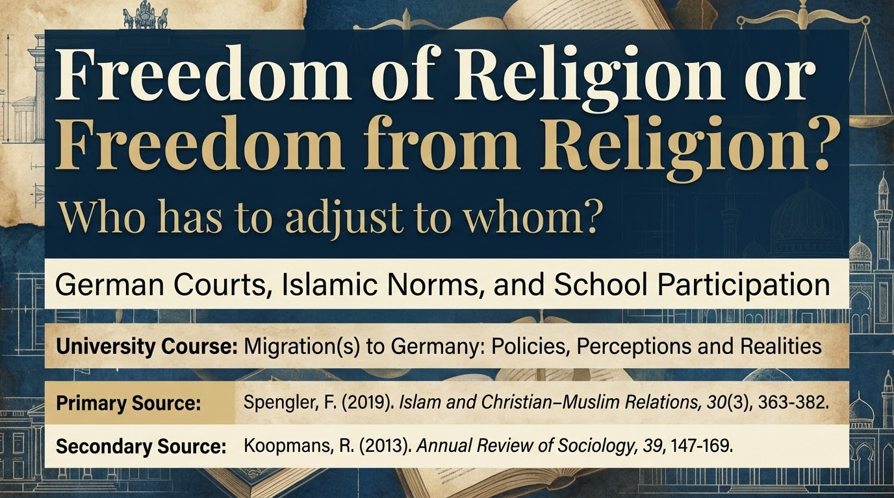

Slide 26
Key Takeaways
Courts shifted from 1980s accommodation → 2010s integration-via-conformity
Not law changing, but societal attitudes (media, politics, secularization)
Problem tiny (21 cases over 44 years), but symbolically huge
Germany's debate reflects religious rights conflicts, not ethnic diversity
Muslim community divided on accommodation; no monolithic position
Key question: Can pluralism survive mandatory conformity?
Source: Spengler (2019) synthesis. Koopmans (2013) comparative context.

Slide 27
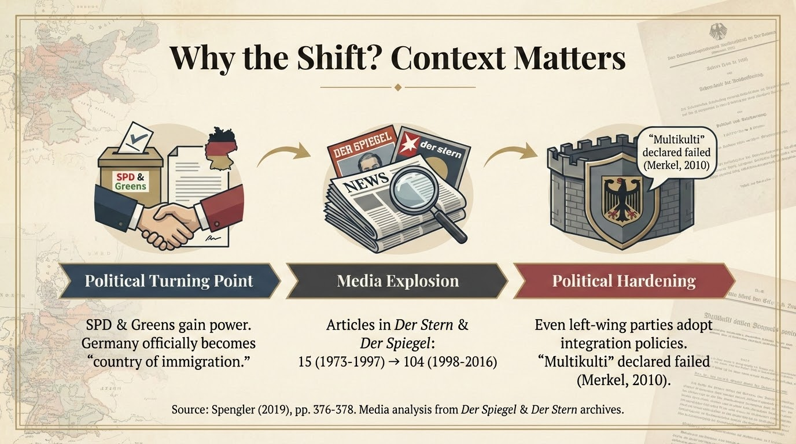

Slide 28
Freedom of Religion or
Freedom from Religion?
The answer defines what kind of society we want to be.
Does integration require uniformity, or can it embrace difference?
Presentation Sources:
Spengler, F. (2019). Islam and Christian–Muslim Relations, 30(3), 363-382.
Koopmans, R. (2013). Annual Review of Sociology, 39, 147-169.

