Slide 1
Mischlingskinder
Afro-German Children in Post-War Germany
5,000–7,000 Stories of Identity, Belonging & Resistance

Slide 2
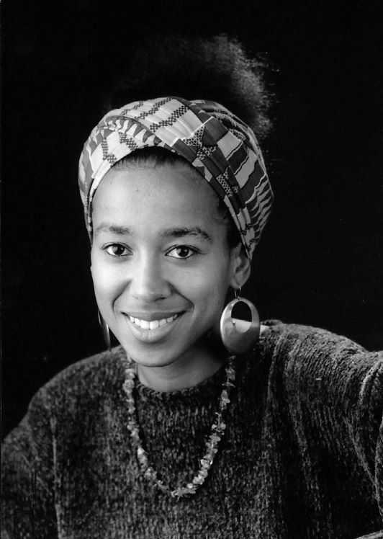
Voices from the Past
May Ayim (1960–1996)
Poet, activist, co-founder of Initiative Schwarze Deutsche (ISD)
"I have lived and experienced more than many..." — suicide note, Aug. 1996
Source:
Her anthology Farbe Bekennen (1986) / Showing Our Colors: Afro-German Women Speak Out broke silence on lived experiences.
Ref:

Slide 3
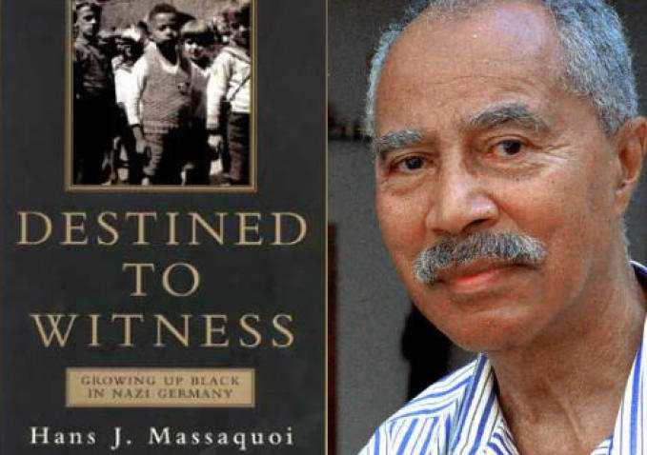
Hans Massaquoi: Nazi to American Dream
Born 1926, Hamburg. Child of German mother & Liberian diplomat father.
Survived Nazi era (low-priority for extermination due to small numbers).
Later: Managing Editor of Ebony Magazine in USA.
Autobiography: Destined to Witness: Growing Up Black in Nazi Germany (1999)
Film (2006): | Book:

Slide 4
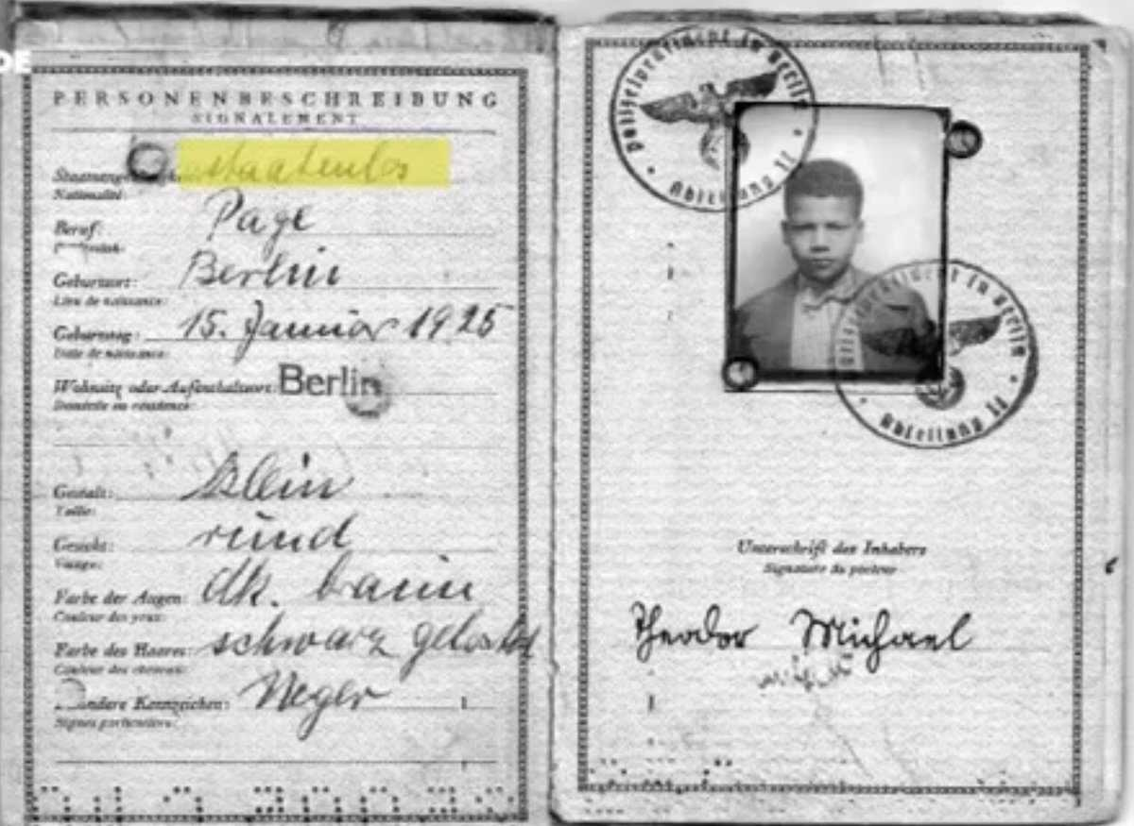
Theodor Wonja Michael: Survivor & Witness
Born 1925, Berlin. Forced into "human zoos" during childhood.
Only survivor of pre-WWII Afro-German cohort to write memoir.
Autobiography: Black German (2018 English trans.)
Featured in DW documentaries as living testimony.
Source:

Slide 5
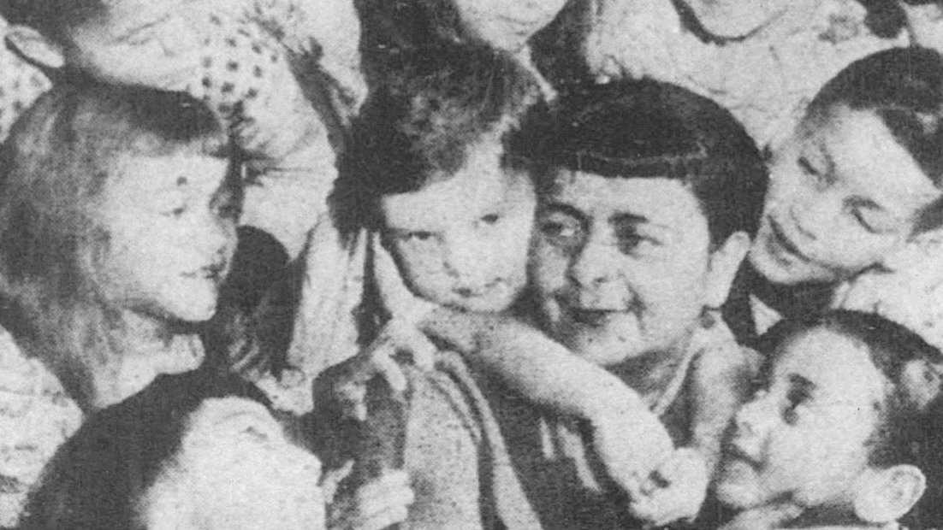
Mabel Grammer: "Children's Airlift"
American journalist & activist (1920s–2000s)
Stationed in Mannheim, Germany (1950). Discovered orphanages full of Afro-German children.
"Brown Baby Plan": Facilitated adoption of 500+ children to Black American families.
Personally adopted 12 children. Recognized by Pope Paul VI (1968).
Sources: |

Slide 6
Katharina Oguntoye: Naming & Reclaiming
Obermayer Award-winning Afro-German scholar & activist
1986: Co-authored Farbe Bekennen with May Ayim & others
Master's thesis (1986): Eine Afro-Deutsche Geschichte — first systematic history of Afro-Germans (1884–1950)
Pioneered term "Afro-German" to reclaim identity; documented Nazi persecution
Key insight: "We Black Germans began the search for our identity"
Source:

Slide 7
Essential Sources & Documentaries
Books: Farbe Bekennen/Showing Our Colors (Ayim et al., 1986); Destined to Witness (Massaquoi, 1999); Black German (T. Michael, 2018)
Film: (2019 interview)
Documentary: (DW, 2017) — features T. Michael & others
Academic: (JSTOR) — scholarly analysis of occupation children
All links verified 2026

Slide 8
The Occupation (1945–1951): Why These Children Existed
Context: ~94,000 occupation children born to German mothers & Allied soldiers; ~5,000–7,000 were Afro-German.
Black GIs: Escaped Jim Crow South — first time without segregation laws
Fraternization rules officially banned, but widely ignored by desperate population
US formally recognized children as orphans under Displaced Persons Act (1951)
Problem: German society viewed children as unwanted racial "stains" on postwar recovery
Source:

Slide 9
The German Response: Erasure & Marginalization
Denied citizenship: No legal status despite being born in Germany
Forced into orphanages: Many separated from living mothers due to social stigma
Racial resentment: Blamed for "contaminating" German racial purity post-Nazi ideology
No adoption in Germany: German families refused; adoption reframed as "rescue" to America
Postwar irony: Nazi sterilization of earlier Afro-Germans (1937) had targeted same population
Academic source:

Slide 10
Legacy: Identity Fragmentation & Delayed Justice
Those adopted to USA: Cut off from birth country, navigating American racism & Jim Crow South
Those remaining in Germany: Excluded from German society; marginalized through 1970s–1980s
1980s Turning Point: Afro-German movement (ISD) emerges; May Ayim & Katharina Oguntoye reclaim voice
Contemporary reckoning: Germany now acknowledging colonial past & post-war racial injustice
Question: Was "adoption" help or complicit erasure?
Source:

Slide 11
Questions for Reflection
How did postwar Germany attempt to "solve" the race question through adoption?
Why were personal narratives (May Ayim, Theodor Michael) so crucial to reclaiming this history?
What does the 40-year silence (1950s–1980s) tell us about German national identity?
How do we distinguish between genuine help and systemic erasure?

Slide 12
Conclusion
The Mischlingskinder represent a pivotal, often-erased chapter in German social history—revealing how race, national identity, and belonging were contested in postwar society.
Their voices matter: From May Ayim's poetry to Theodor Michael's testimony, from Katharina Oguntoye's scholarship to Mabel Grammer's activism—these are stories of resistance, survival, and reclamation.
Further reading: |

