Slide 1

NetIS™ One Engine
The 21st Century ePublishing Platform
Reclaim What’s Yours

Slide 2
Agenda
1. Traditional publishing business
2. Direct ePublishing the way it SHOULD be
3. Retailer ePublishing the way It Is
4. Direct ePublishing The Way it SHOULD be
5. Advantages of DIRECT ePublishing with NetIS™
6. Advantages of the “Middle Man”
7. Adding “Add to Cart”
8. Core NetIS Modules

Slide 3


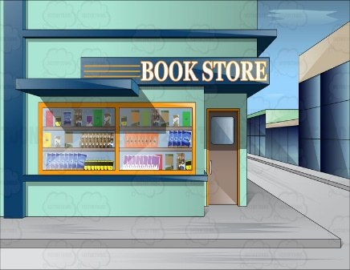

Traditional Publishing Business
1. Book published
4. Reader pays retailer
2. Book shipped to retailer
5. Retailer keeps 50%
3. Retailer sells to reader
6. Publisher receives 50%
$12
$24

Slide 4

Direct ePublishing The Way it SHOULD be
1. Book published
3. Reader pays publisher
2. File transferred to reader
4. Publisher receives 100%
$12
$24

Slide 5

Retailer ePublishing the Way It Is
We got rid of the middle man
But created a new one instead
$12
$24

Slide 6
Advantages of DIRECT ePublishing with NetIS™
With NetIS you own the buyer information. You know who likes which books. You can analyze their buying patterns, locations and much more. You can then use all that for further marketing actions. That’s what the retailers do, with YOUR readers.
YOU choose sale format. Regular sale, Subscriptions, “All you can read”, Etc.
People buy paper books directly from your website. But for ebooks you send them elsewhere. No more.
Selling through retailers makes THEIR brand name grow. Not Your’s!
1. Double the Revenue
Retailers have their own interests in determining book price.
Sales via retailers result in 50% decrease in gross income. Sometimes more…
2. Control over pricing strategies
3. Brand growth & awareness
4. Control types of sales
5. Monetize your website exposure
5. Know your readers
With NetIS™ YOU control what’s YOURS

Slide 7
Advantages of the “Middle Man”
How can we ensure our eBook files to be compatible with all those eReaders out there?
1. Hassle free
Online retailers have huge customer bases. We cannot loose those customers.
We are publishers. Not programmers! We can’t build and maintain such a technological platform.
2. Access to vast customer base
3. Platform Diversity
$12
$24

Slide 8
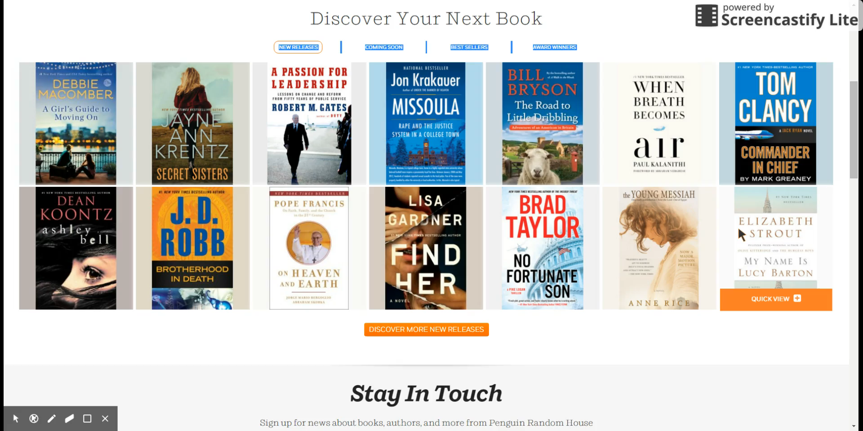
Adding “Add to Cart”

Slide 9
Core NetIS Modules
NetIS™ Dashboard
Digital Rights Management (DRM)
Authentication methods:
e-commerce tools
Multitude of Protection Levels:
Users Management
Targeted CRM module
Optimizing Content for Search Engines
Payment Interfaces

Slide 10
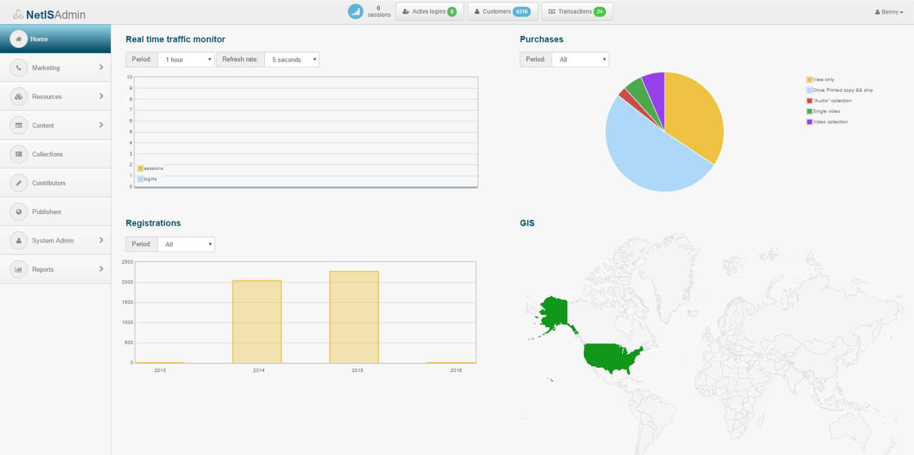
NetIS™ Dashboard
supplying up to the minute information regarding the usage and sale of products, real time monitoring of traffic, GIS information representing the customers geographic split, customers' activities and number of transactions. On the top bar of NetIS dashboard is displayed the following real time information: active logins, number of customers, transactions and number of session (the information can be drilled down).

Slide 11

Digital Rights Management
(DRM) module to secure and safeguard premium and sensitive content (PDF, Epub, HTML5), with multiple authentication and authorization methods, including the limitation of standard functions:
o Viewing and previewing of content
o Selecting/Copying/Pasting and Saving
o Online reading vs. Offline reading
o Video clip preview (streaming teasers limited on time).

Slide 12
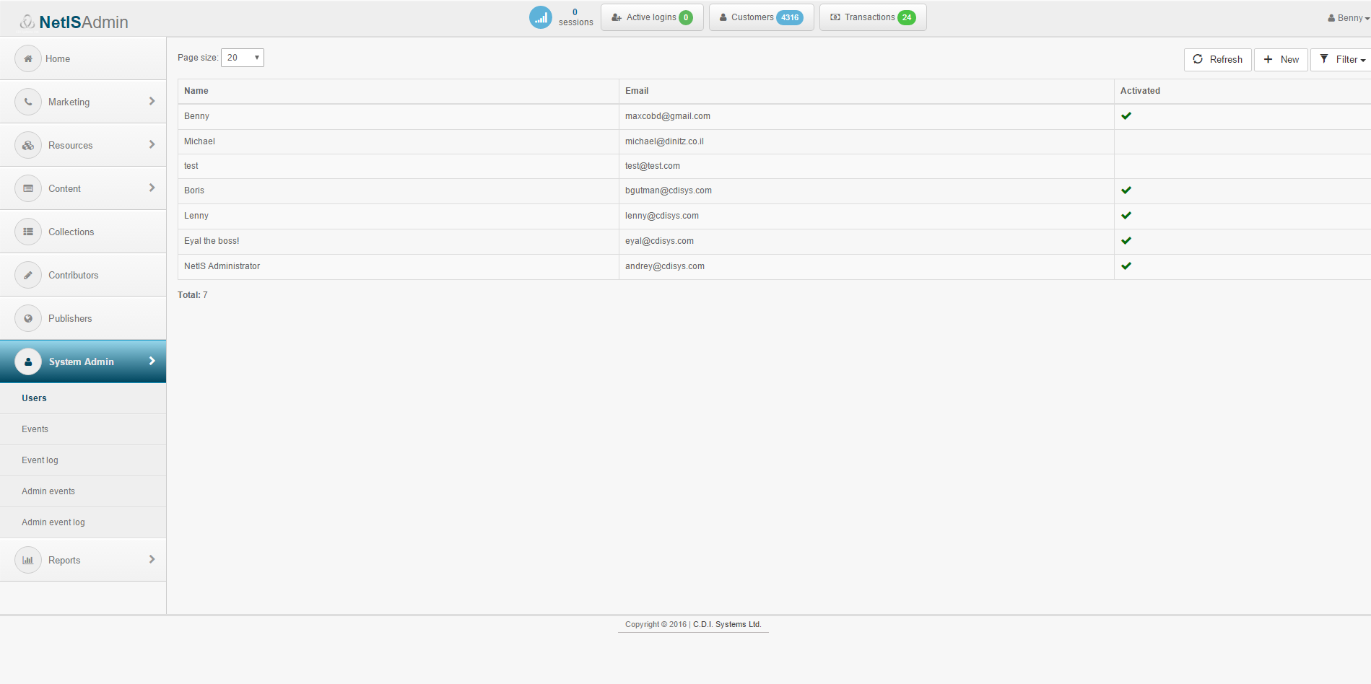
Authentication methods
Wide array of Authentication methods:
o User name and password
o IP address or IP range(s)
o Tablet & Mobile authentication and registration
o Authentication of guest users (not logged in or not registered users) to provide limited usage rights (“Try before you Buy” and Teasers).

Slide 13
e-commerce tools
Integrated e-commerce tools enabling the content owner to sell products in a myriad ofsmart sales scenarios:
o Purchase of content impressions (one time view)
o Purchase of content subscriptions
o Purchase of functionality based rights (i.e. the right to save, print, export content)
o Purchase of counters based rights (i.e. the right to print content 10 times)
o Purchase of time based rights (i.e. the right to view content for 3 hours or 2 days)
o Purchase of combined products (e.g. printed and ebook as one product)
o “Try before you buy” (teasers & previews).

Slide 14
Multitude of Protection Levels
o Medium protection for online reading (clientless)
o High Offline protection (requires installation of a thin client)
o Watermarking (PDF) – the text, font size and position can be determined on the page where each e-book/document will be watermarked on the fly.

Slide 15
Users Management
Powerful Concurrent Users Management mechanism, that enables:
o Controlling and managing the number of actual users per account
o Locking user accounts to specific devices/computers
o The proper policy can be defined in Settings from one of the following options:
▪ Each "above quota" login will be allowed but monitored (increased or illegal usage can be detected and acted upon later, by limiting access or by increasing the customer’s usage fees).
▪ Warn the customer when the number of concurrent users is "above
quota".
▪ Unconditionally deny login when the number of concurrent users is “above quota”.

