Slide 1

NetIS™ One Engine
The 21st Century ePublishing Platform
Reclaim What’s Yours

Slide 2
Agenda
1. Traditional Book Business
2. ePublishing the Way It Was Meant to Be
3. Retailer ePublishing the Way It Is
4. Advantages of DIRECT ePublishing with NetIS™
5. Advantages of the “Middleman”
6. Introducing “Add to Cart” for eBook Sales
7. Core NetIS Modules

Slide 3


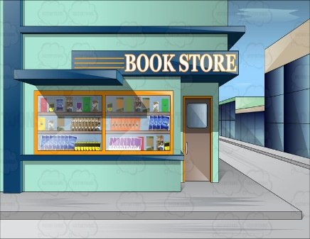

Traditional Book Business
1. Book published
4. Reader pays retailer
2. Book shipped to retailer
5. Retailer keeps 50%
3. Retailer sells to reader
6. Publisher receives 50%
$12
$24

Slide 4

ePublishing the Way It Was Meant to Be
1. Book published
3. Reader pays publisher
2. File transferred to reader
4. Publisher receives 100%
$12
$24

Slide 5

Retailer ePublishing the Way It Is
We eliminated the middleman
and created a new one instead
$12
$24

Slide 6
Advantages of DIRECT ePublishing with NetIS™
People buy physical books directly off your website. But for ebooks, you send them elsewhere.
With NetIS you own the buyer information. You know who likes which books. You can analyze their buying patterns, geographic location, and real-time actions. You can then use all that for further marketing decisions.
That’s what the retailers do, with YOUR readers.
Retailers aim to make THEIR brand name grow—not yours!
1. Double the Revenue
Retailers have their own interests in determining book price.
Sales via retailers result in 50% decrease in gross income. Sometimes more…
YOU choose the sales format. Regular sales, subscriptions, “all you
can read” and more.
2. Control pricing strategies
3. Create brand growth & awareness
4. Control types of sales
5. Monetize your website exposure
5. Know your readers
With NetIS™ YOU control
what’s YOURS

Slide 7
Advantages of the “Middleman”
Online retailers have huge customer bases. We cannot lose those customers.
1. Hassle free
Can we ensure our ebook files will be compatible with all the eReaders out there?
We are publishers. Not programmers!
We can’t build and maintain a complex technological platform.
2. Access to vast customer base
3. Platform diversity
$12
$24

Slide 8
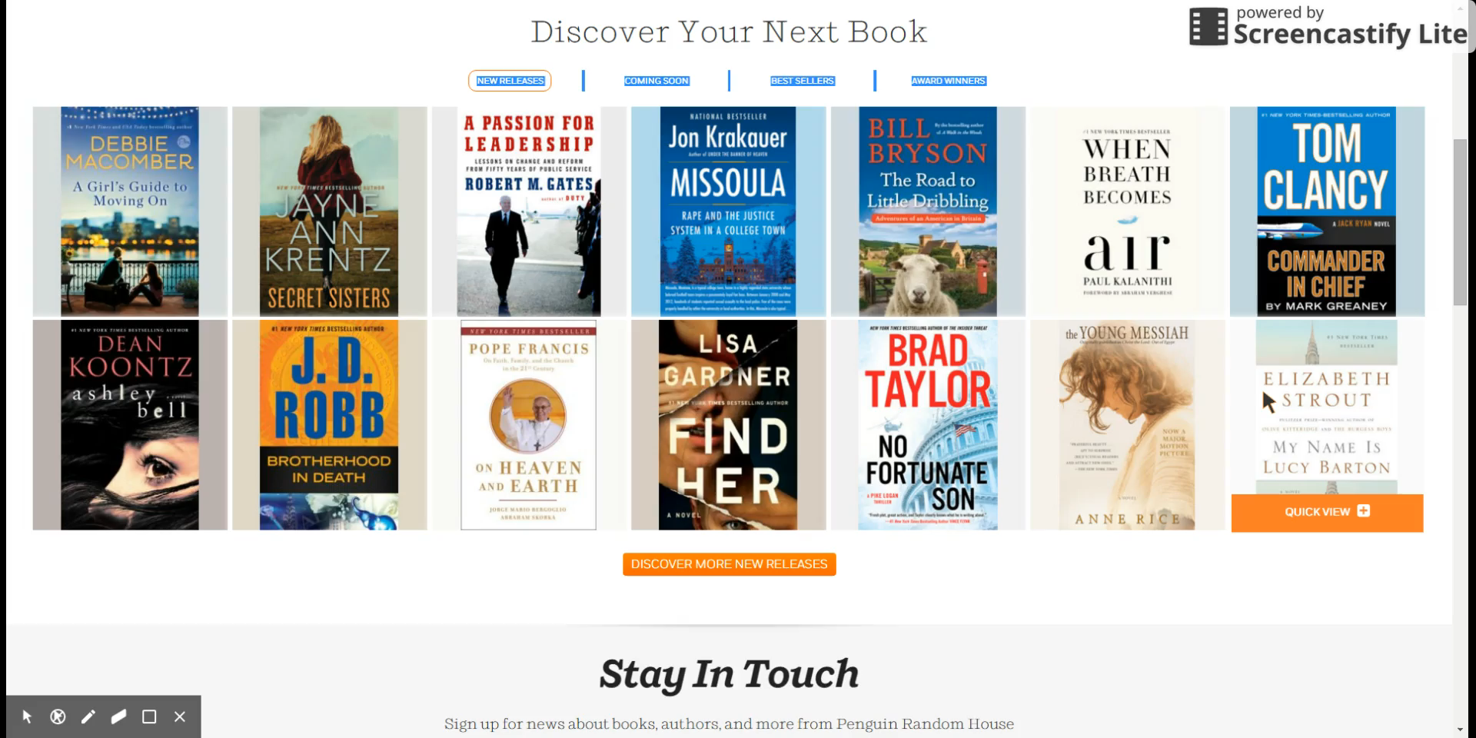
Introducing “Add to Cart” for eBook Sales

Slide 9
Core NetIS Modules
NetIS™ Dashboard
Digital Rights Management (DRM)
Authentication Methods
e-Commerce Tools
Multiple Protection Levels
Users Management
Targeted CRM Module
Optimizing Content for Search Engines
Payment Interfaces

Slide 10
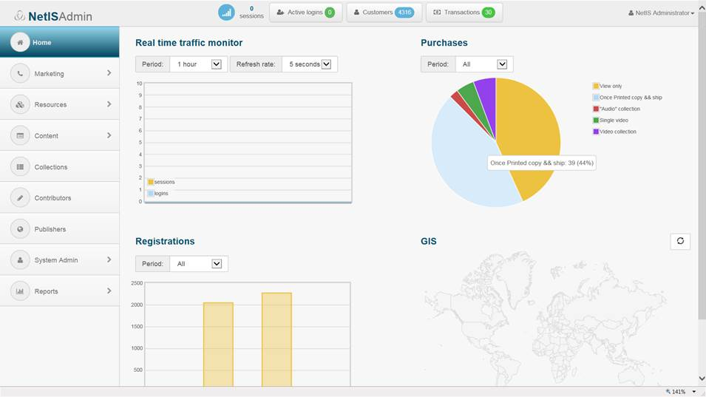
NetIS™ Dashboard
supplies up to the minute information regarding the usage and sale of products, real time monitoring of traffic, GIS information representing the customers’ geographic split, customers' activities, and their number of transactions. The top bar of the NetIS dashboard displays the following real time information: active logins, number of customers, customer transactions, and number of sessions (the information can be drilled down).

Slide 11

Digital Rights Management
(DRM) module secures and safeguards premium and sensitive content (PDF, ePub, HTML5), with multiple authentication and authorization methods, including the limitation of standard functions:
Viewing and previewing of content
Selecting/Copying/Pasting and Saving
Online reading vs. Offline reading
Video clip preview (streaming teasers limited in time).

Slide 12
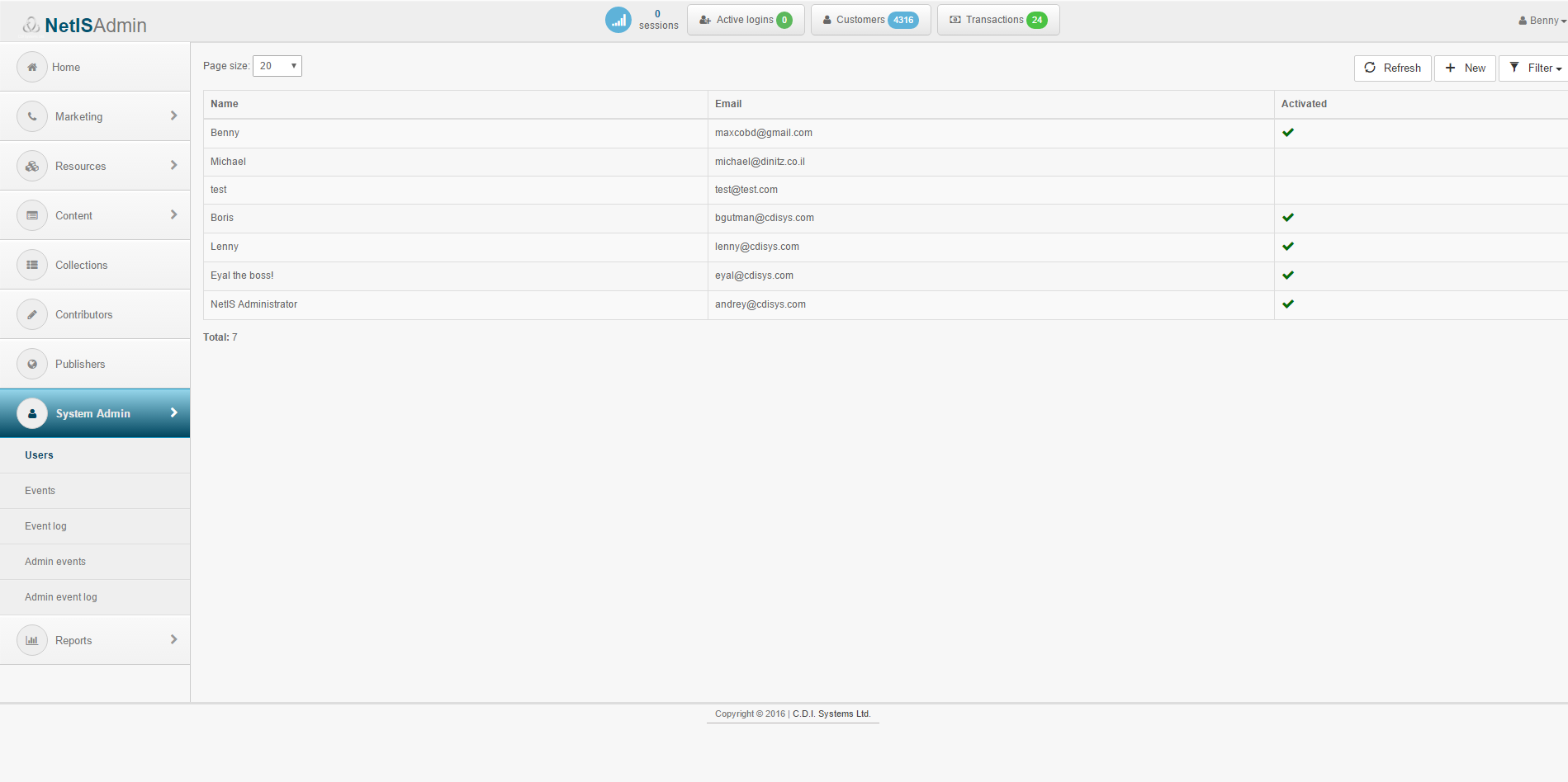
Authentication Methods
Wide array of Authentication Methods:
User name and password
IP address or IP range(s)
Tablet & Mobile authentication and registration
Authentication of guest users (not logged in or unregistered users) to provide limited usage rights (“Try before you buy” and Teasers).

Slide 13
e-commerce Tools
Integrated e-commerce tools enabling the content owner to sell products in a range of smart sales scenarios:
Purchase of content impressions (one-time view)
Purchase of content subscriptions
Purchase of functionality-based rights (i.e., the right to save, print, export content)
Purchase of counter-based rights (e.g., the right to print content 10 times)
Purchase of time-based rights (e.g., the right to view content for 3 hours or 2 days)
Purchase of combined products (e.g., print and ebook as one product)
“Try before you buy” (teasers & previews).

Slide 14
Multiple Protection Levels
Medium protection for online reading (clientless)
High Offline protection (requires installation of a thin client)
Watermarking (PDF) – the text, font size and position can be determined on the page where each e-book/document will be watermarked on the fly

Slide 15
Users Management
Powerful Concurrent Users Management mechanism, that enables:
Controlling and managing the number of actual users per account
Locking user accounts to specific devices/computers
Defining proper policy in Settings from one of the following options:
    Each "above quota" login will be allowed but monitored (increased or illegal usage can be detected and acted upon later, by limiting access or by increasing the customer’s usage fees)
    Warn the customer when the number of concurrent users is "above quota“
    Unconditionally deny login when the number of concurrent users is “above quota”

