Slide 1

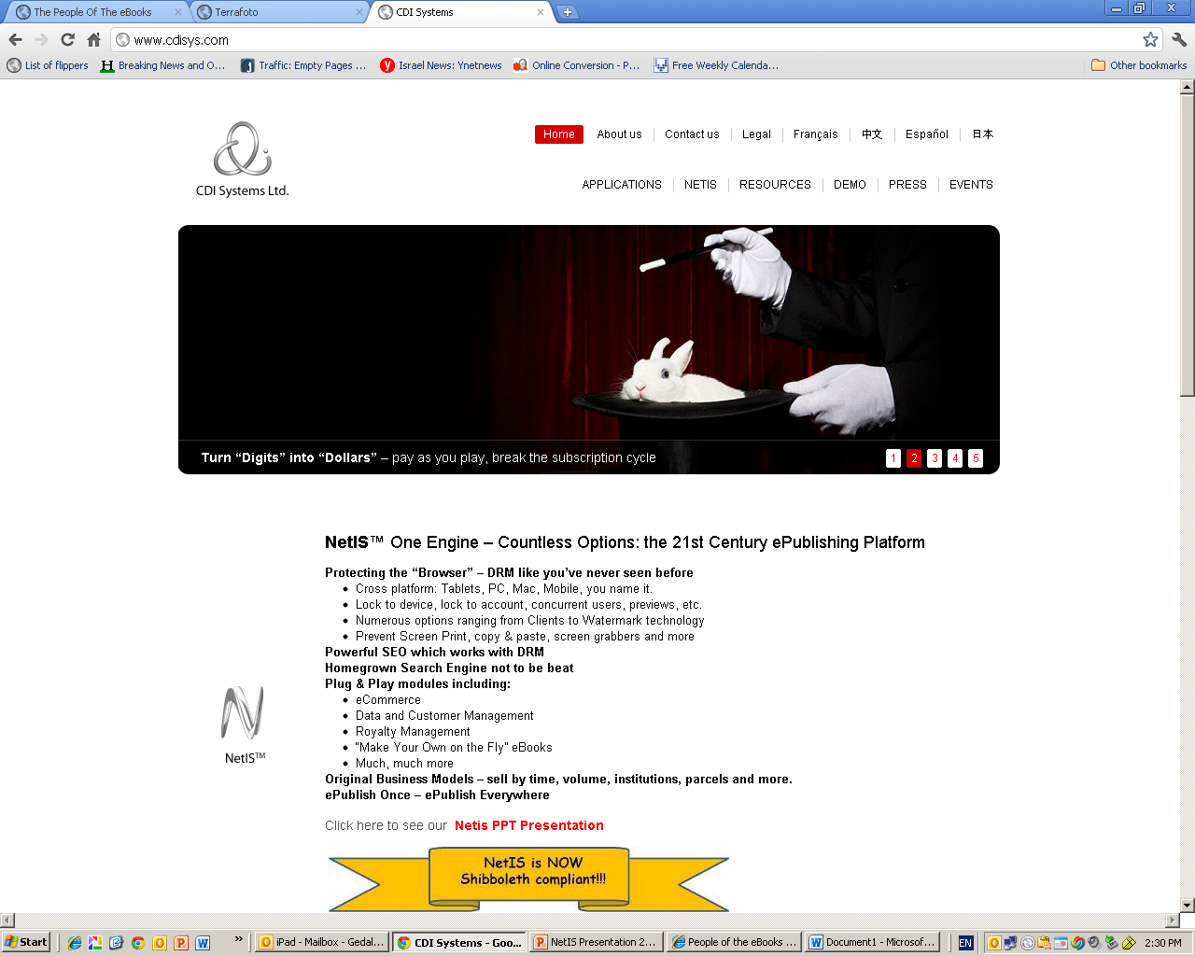
CDI Systems is proud to present:
NetIS™
Sell Books on Your OWN
A real ecommerce platform for the secure distribution and sales of content

Slide 2
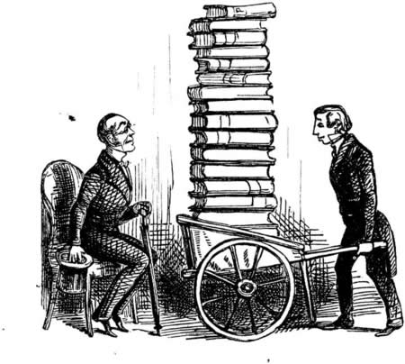

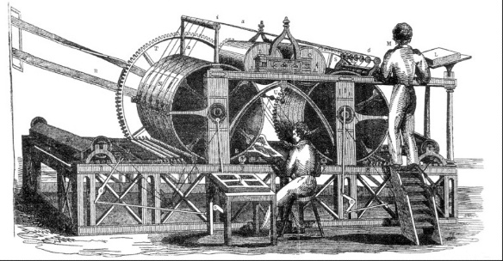
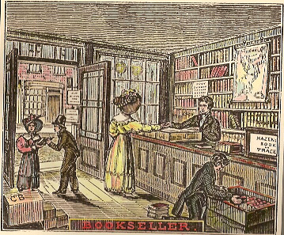


Traditional Book Cost Structure
Author Royalties
Book Preparation
Print
Distribution
Promotion
Wholesaler

Slide 3
Digital Content
Author Royalties
Book Preparation
Print
Distribution
Promotion
Wholesaler

Slide 4
The Middle Man
Author Royalties
Book Preparation
Print
Distribution
Promotion
Wholesaler

Slide 5




The Middle Man
Author Royalties
Book Preparation
Promotion

Slide 6

The Middle Man

Slide 7
The Middle Man

Slide 8
Advantages Reader
Book selection from numerous publishers
Compliance with proprietary digital reader
Various payment & subscription plans

Slide 9
Advantages Reseller
Fees, Commissions, Income. Virtually effortlessly
Sales of proprietary digital reader
Brand growth
Big Data on customers

Slide 10
Advantages Publisher
Easy. No need to deal with digital books sales.
Access to reseller’s large customer base

Slide 11
Disadvantages Publisher
Reseller takes a LARGE part of the reveue (30-70%)
Loss of ability to freely determine prices (Even with non-didgital)
Loss of brand name and prestige
Diminished marketing abilities, lack of information
And access to buyers

Slide 12

Adding “ADD to CART”

Slide 13
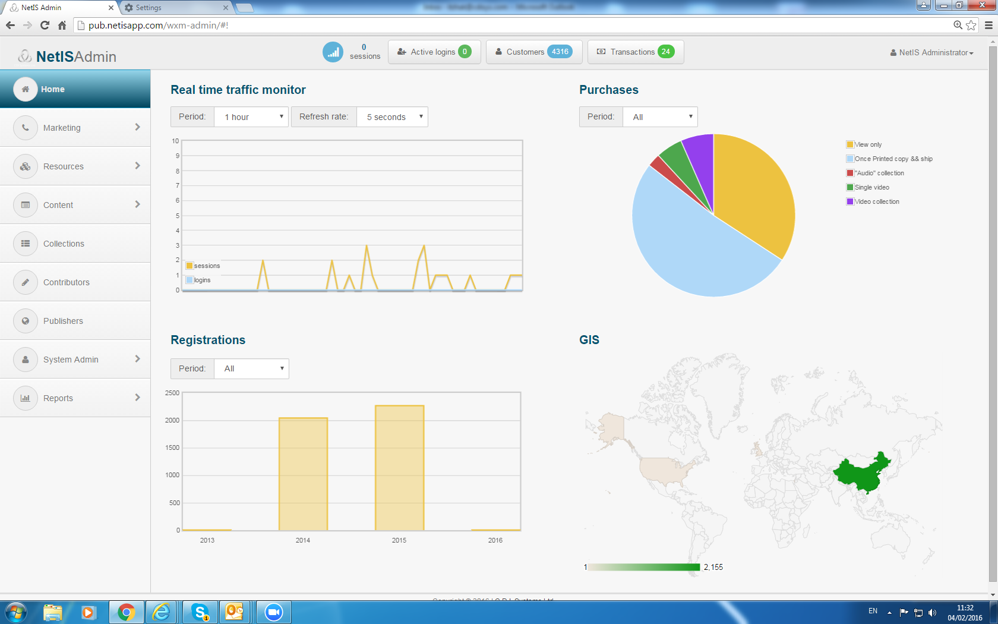
The Solution
NetIS™ 5.0
A powerful ecommerce platform for the secure distribution & sales of content

Slide 14
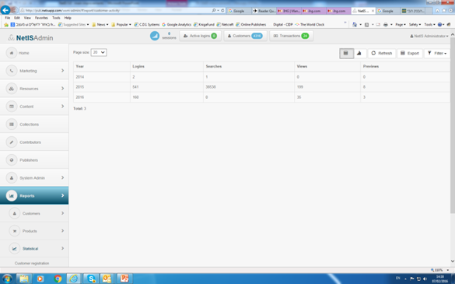
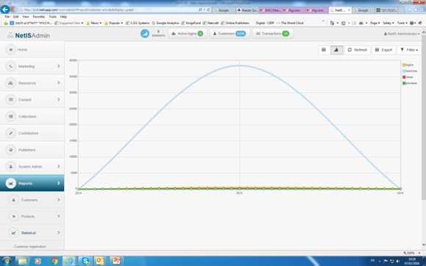
NetIS Basic Modules
Marketing
Resources
Content
Collections
Contributors
Publishers
System Administration
Reports

