Slide 1

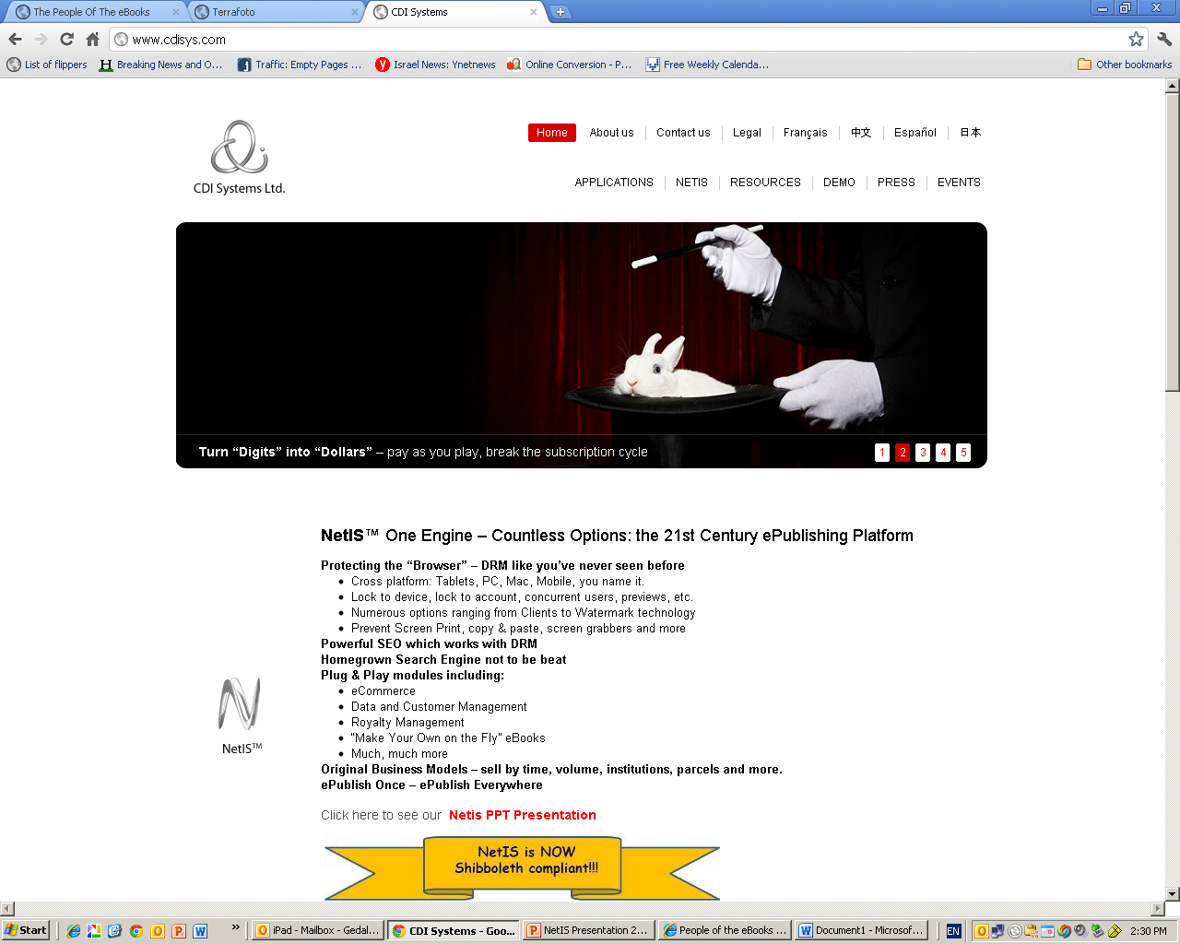

CDI Systems is proud to present:
NetIS™
A real ecommerce platform for the secure distribution and sales of content
Notes:
1

Slide 2
CDI Systems - Background
Headquartered in Jerusalem “Silicon Valley” – Har Hotzvim
A pioneer in the e-publishing industry
First product launched in 1992 – Takdin: ‘Israel’s Lexis-Nexis’
Spun off Takdin in 2010, since then focused on its core technology – NetIS™
Partners in 7 countries, NetIS® available in 6 languages, including Simplified Chinese.
Extraordinary and experienced development & marketing team.

Slide 3
CDI Systems Management Team
Itzhak Levit - Chairman and CEO
Hi-tech entrepreneur ,over 23 years of experience in e-publishing, heading CDI Systems since 2000
Experienced at corporate strategy and in building long-term relationships with clients and partners.
1996 awarded The Best Small Hi-Tech Company of Israel granted by the Prime Minister.
BSC in software engineering.
Former commander of Israeli elite unit.
Rachel Kanat – BD Manager
Key player in developing and marketing strategies for various high tech companies, rich experience in Western European marketplace.
Working for CDI since 2011
MA in Economics from Brussels University, Belgium.
Eyal Tubul – CTO
Over 13 years of experience in e-Publishing technologies Joined CDI in 2000.
Involved in the development of NetIS since day one, served as senior project manager, leaded the development of NetIS mobile infrastructure.
Leaded the development for Dun & Bradstreet smart phones application in the USA and Japan.
Software engineer.

Slide 4



CDI Systems - customers samples

Slide 5
Major vertical markets
Major Market | Target customers | Remark
Education | Middle schools; University and college;
Academic & research institutes | Professional intelligence service providers;
Law /patent/standards | Government departments; Patent bureau; National Standards bureau;
Professional Manual/Documents | Car industry; Mechanical manual;
Pharmacopeia | China Pharmacopeia;
Publishing industry | Press house; Magazines; Periodicals;

Slide 6
What are the most common publishers & content owners concerns ?
How e-Commerce will impact my existing publishing business ?
How I protect my digital assets from piracy?
How I generate revenue from my digital assets ?

Slide 7

NetIS - in the essence
Turn “Digits”
into “Revenues”
Convergence of four technologies:
E-commerce
Digital Rights Management (protected by DRM)
Web Content Management (WCM)
SEO Enhancer

Slide 8
NetIS Modules
1
3
2
4
5
Security
E-commerce
Distribution
Monitoring
Content
Management
A variety of sales model (e.g. subscriptions, single items, bundle, chapter, time based, etc.)
Featured CRM capabilities
Royalties Management
Online Store
Orders and transactions
monitoring
Cross platform responsive UI
SEO friendly
Integration with social networks
email campaigns
Integration with online and mobile viewers
Dashboard
Reports
Purchases
Statistics
Batch processes for content upload and format conversion
Multiple format support
Smart content classifications
Full Text Search
Real time indexing
DRM
Authentication
Unified API
Usage rights (e.g. view, preview print, copy/paste, download)
Configurable Dynamic Watermark
Concurrent Usage
User Groups / Individuals
Login / Password
IP Addresses / IP range(s)
Control # of devices
Single sign on
Social networks
6

Slide 9
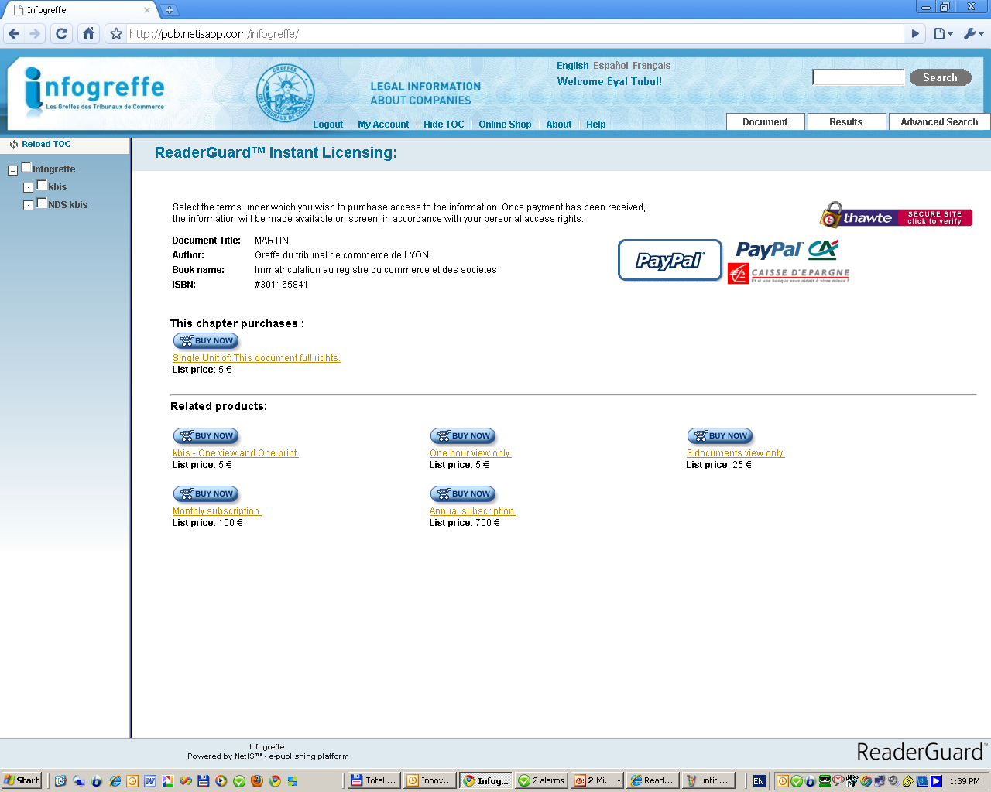
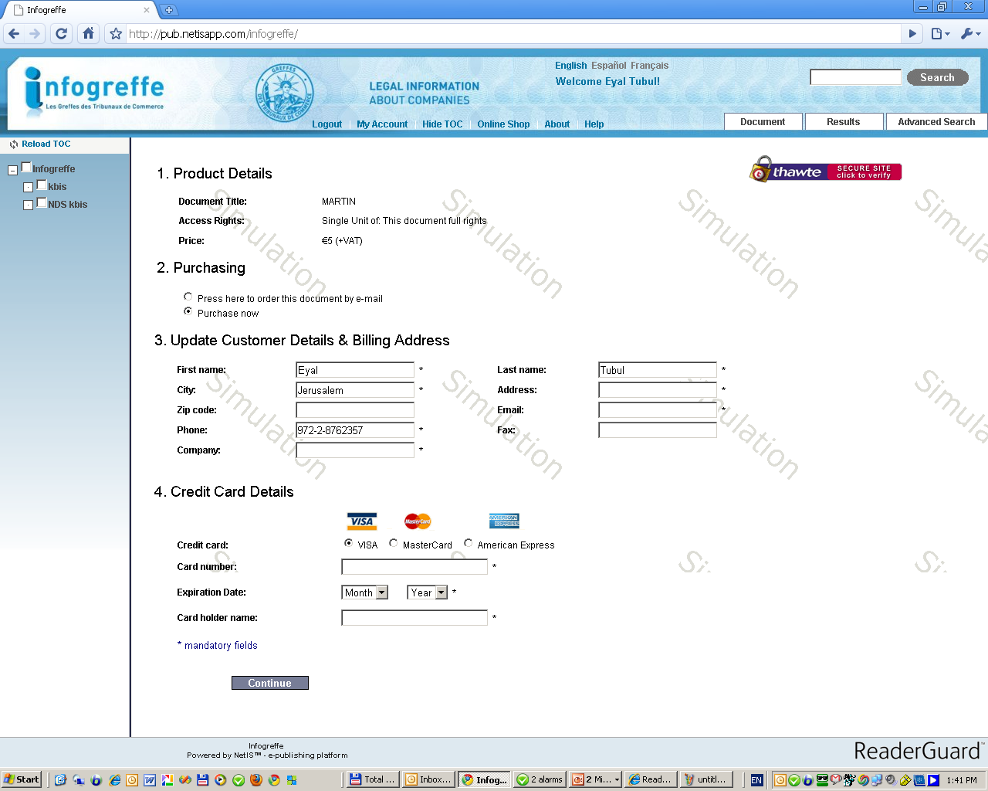
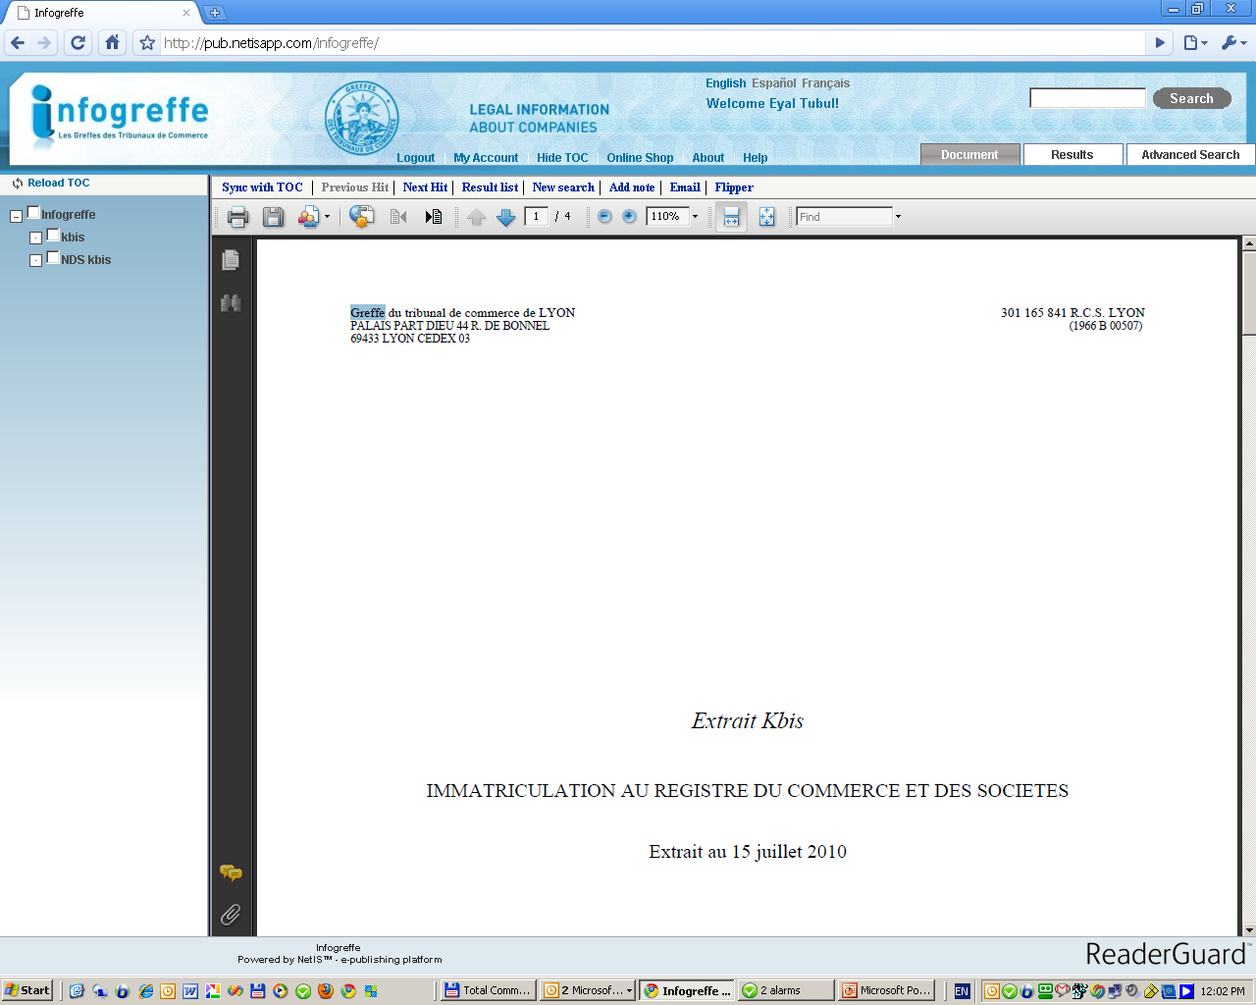
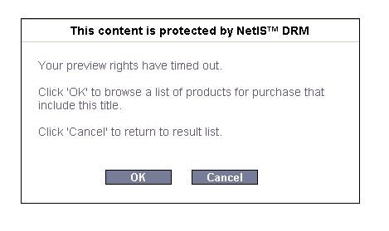
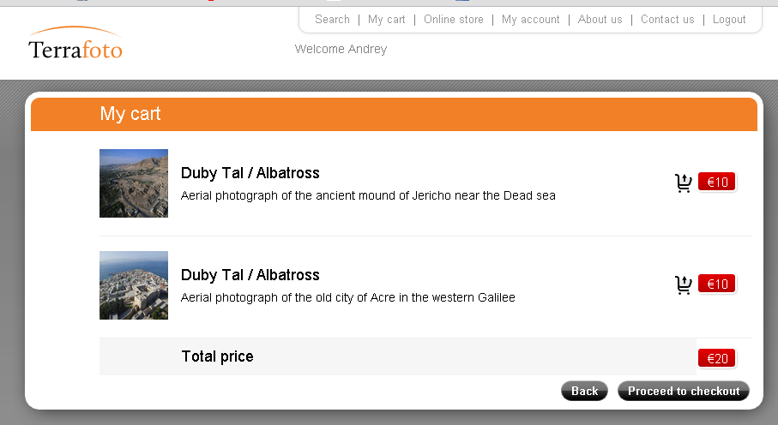
E-commerce – Flexible digital products
Content can be sold in a variety of options:
Preview and Teasers
Time based (Cumulative)
Volume based (Cumulative)
Counter based (Times)
Usage based (per page, per chapter)
Context based
Online & Offline
External Billing Support
Instant Granting of rights
Real Time Monitoring and Auditing of Usage
Notes:
9

Slide 10
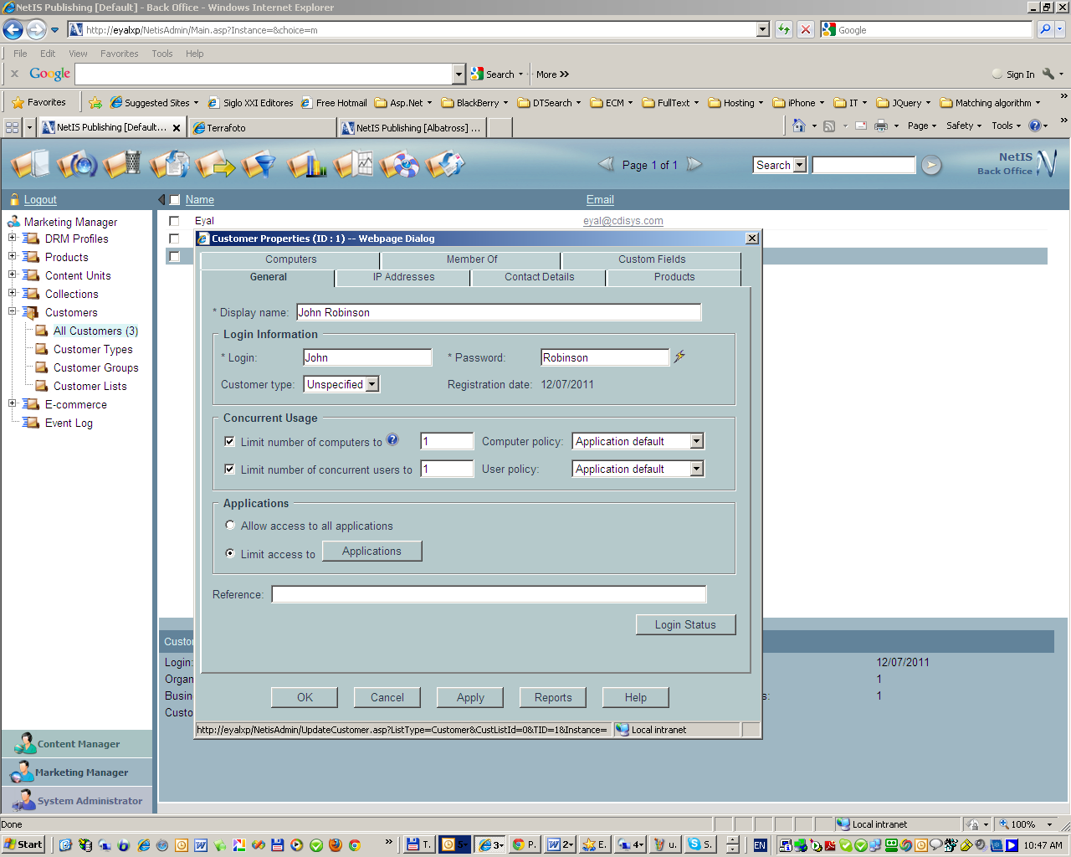
Add & modify users accounts Grant or deny access to content View reports on users activities Search user’s database Apply DRM to content (single files or a group)
eCommerce: Marketing and Sales
Initiate & operate sales, promotions and award programs

Slide 11
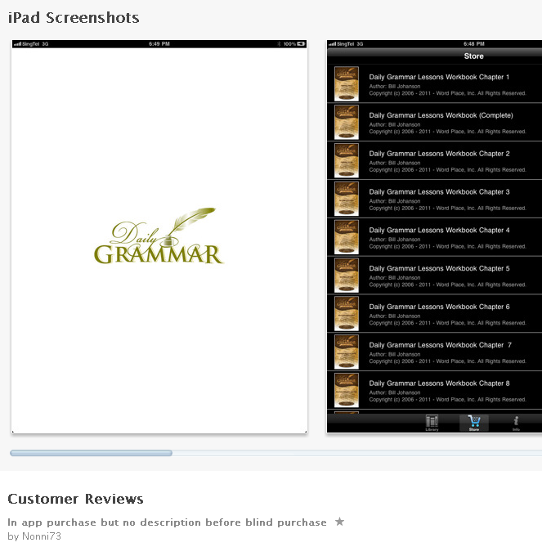
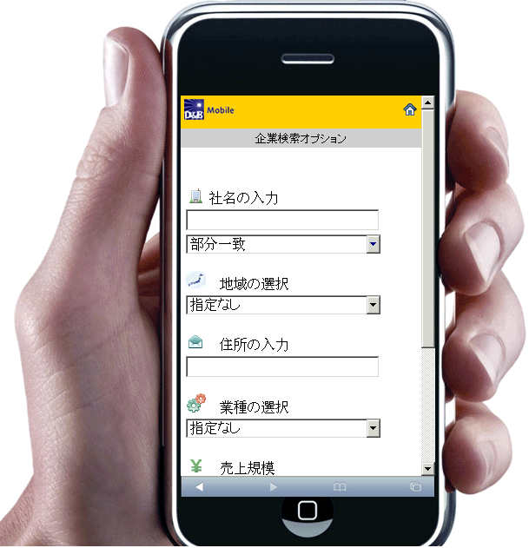

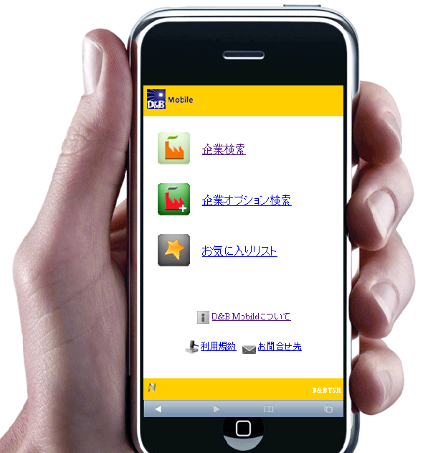
Distribution: Tablets, Mobiles, etc…

Slide 12
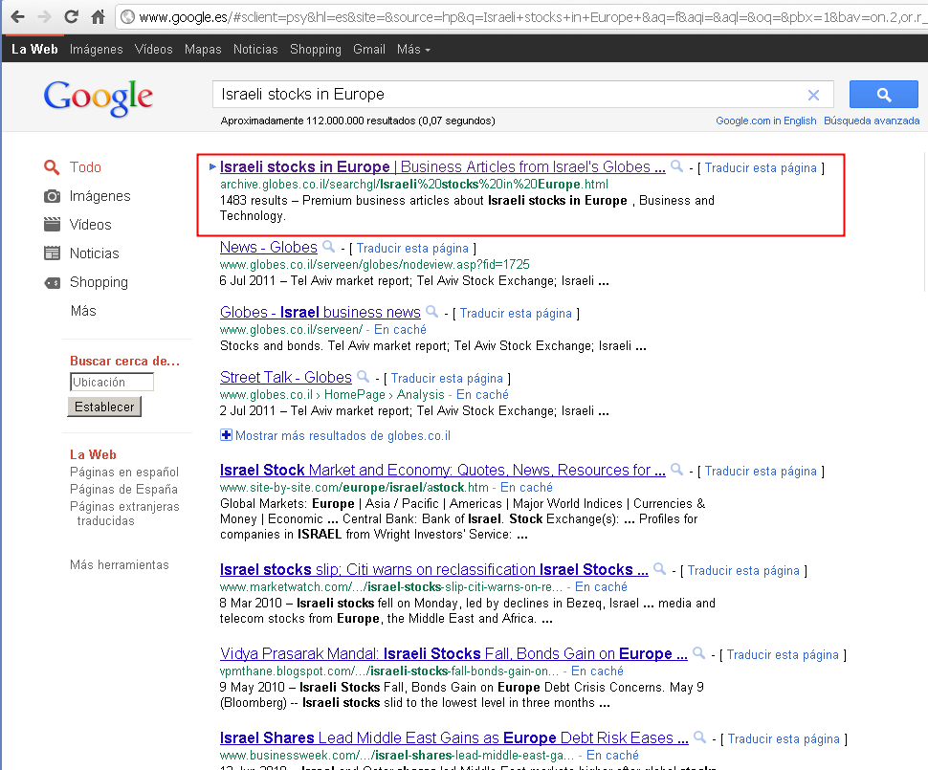

SEO Friendly
…that works with DRM!
First
out of
112,000,000.00 results!
That’s not bad, right, Ms. Seo?

Slide 13
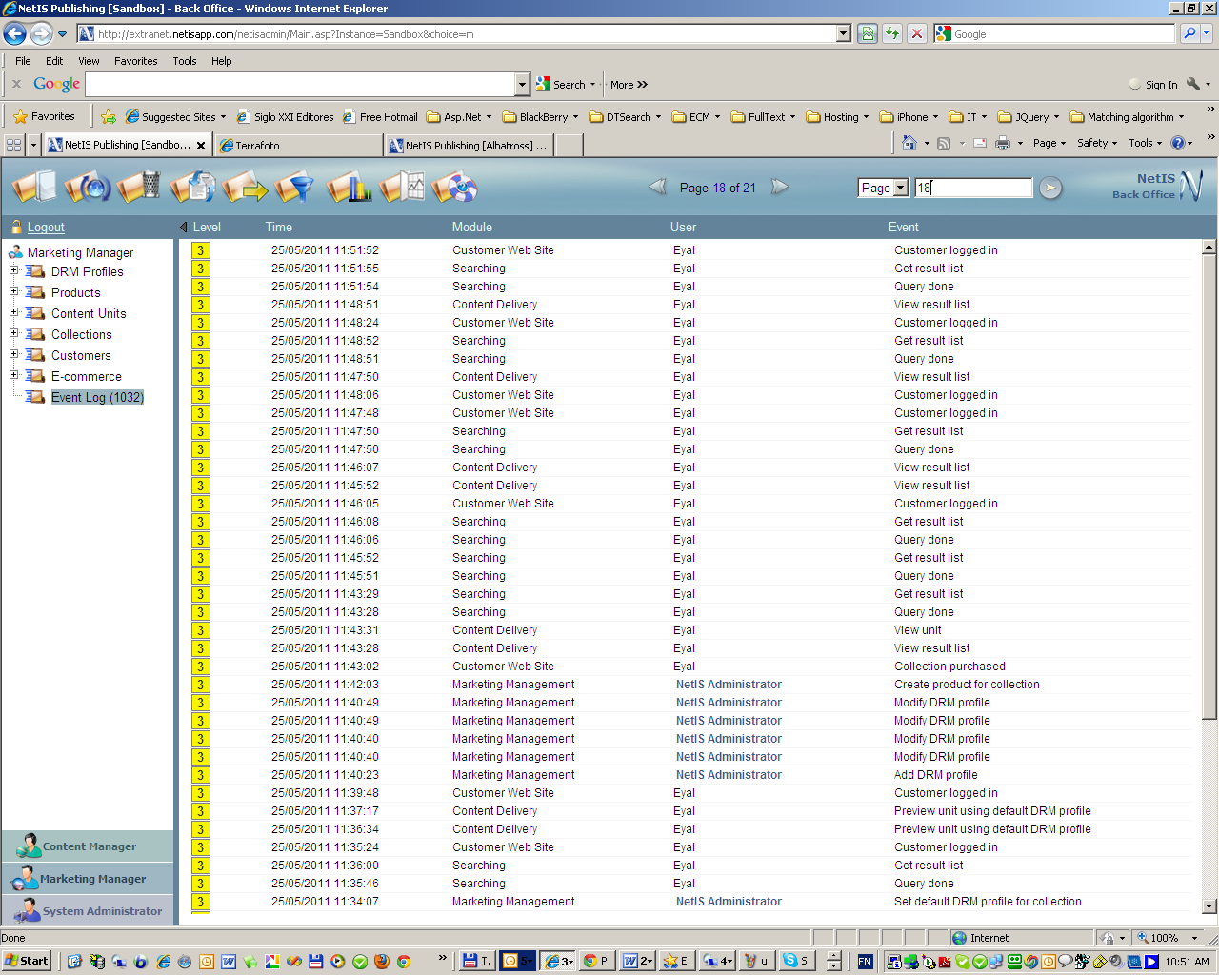
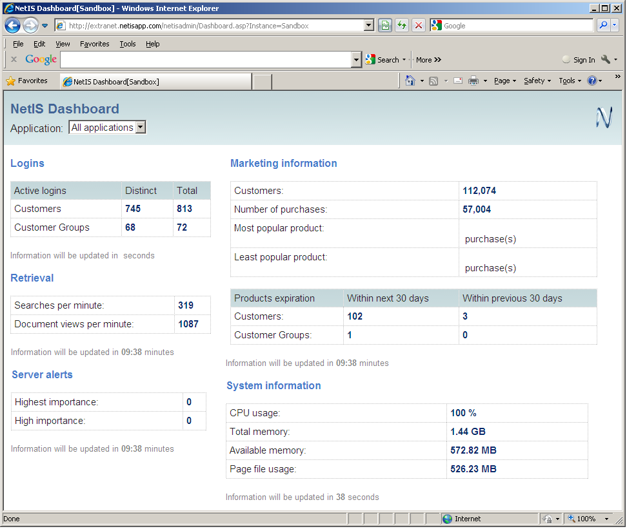
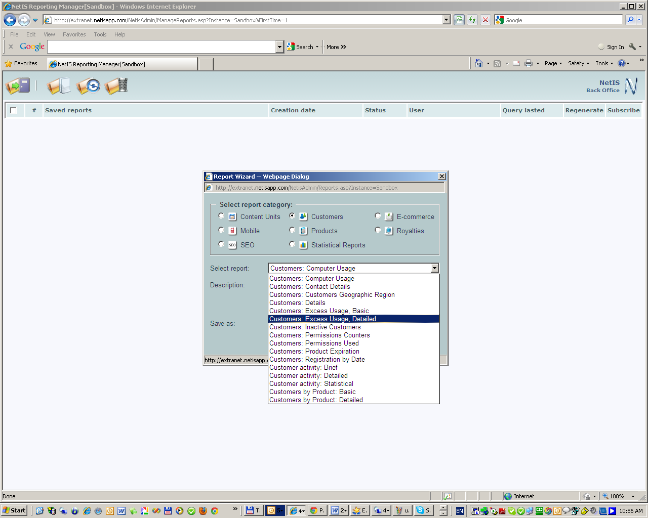
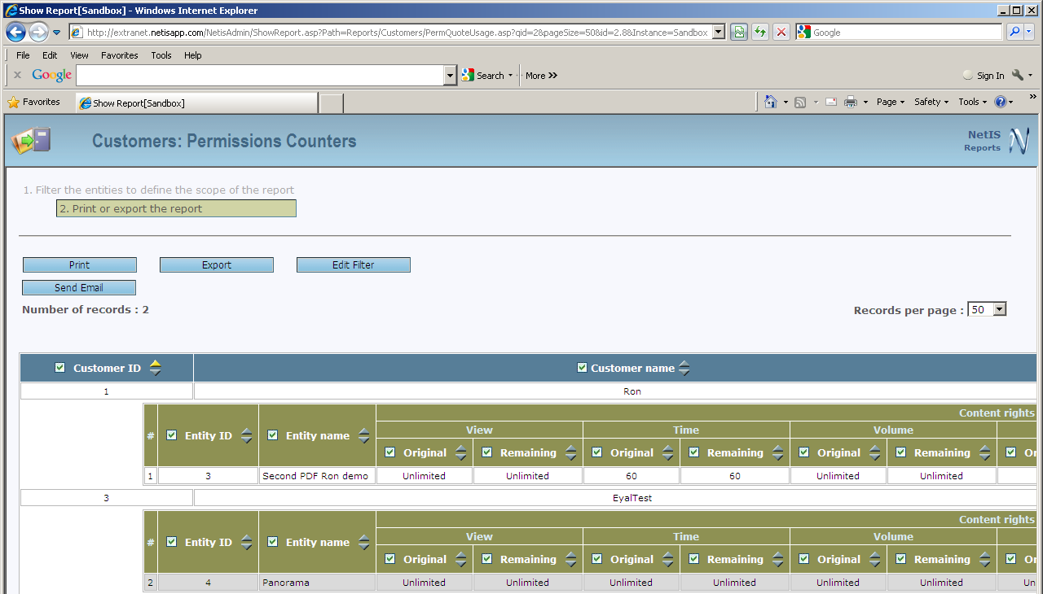
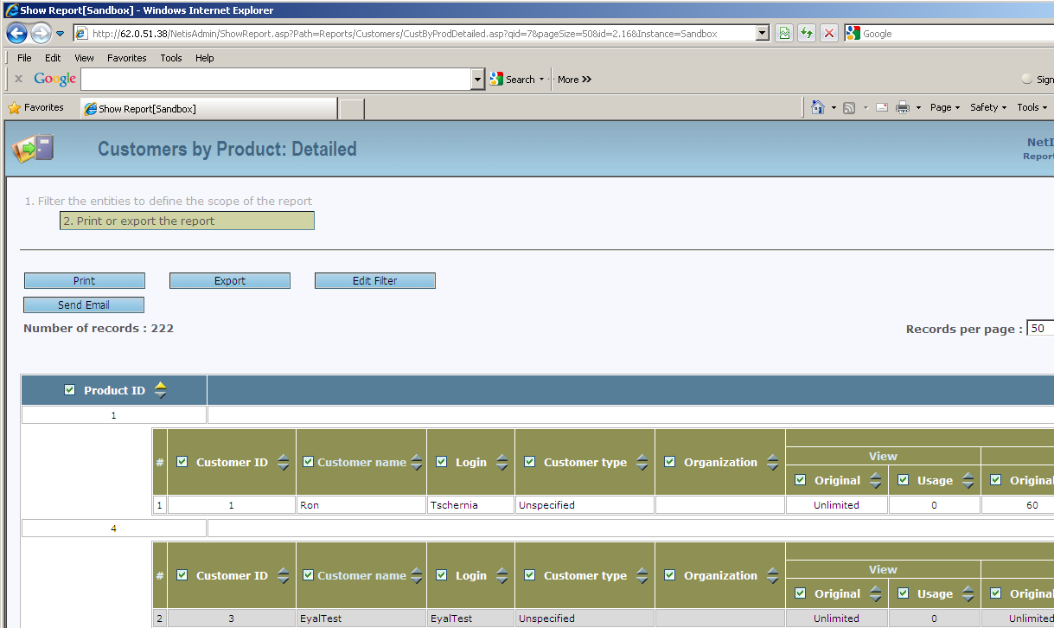
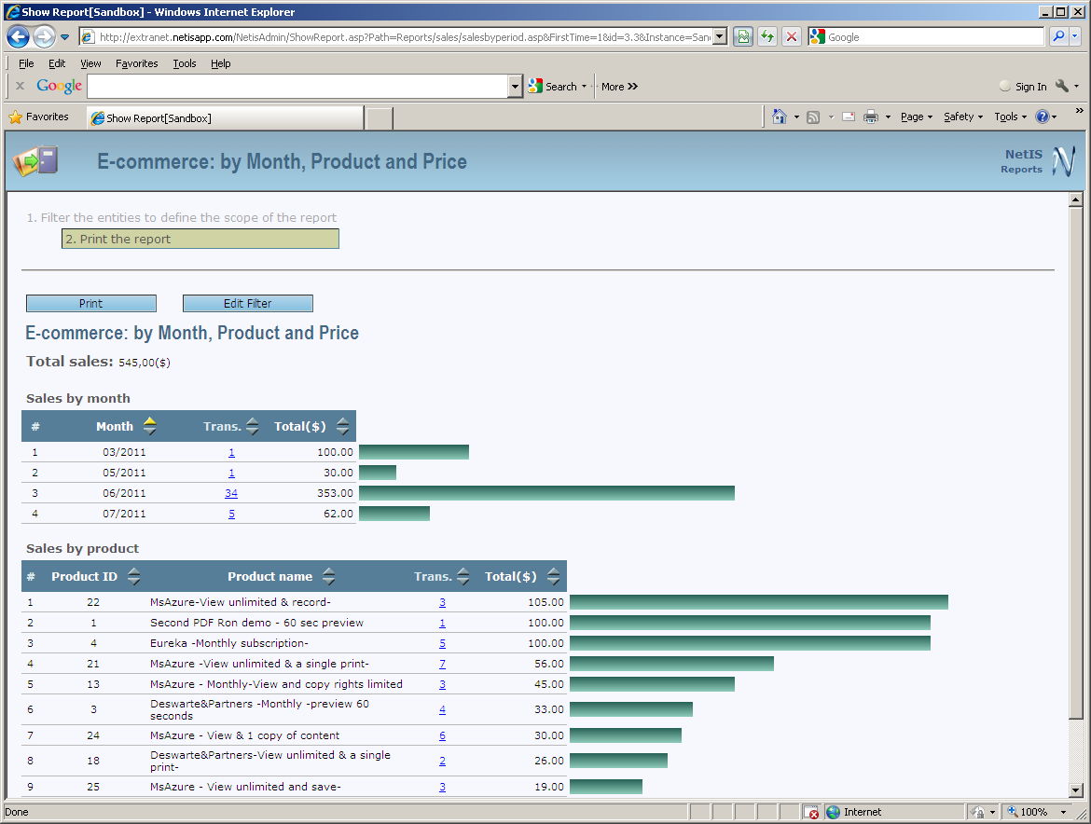
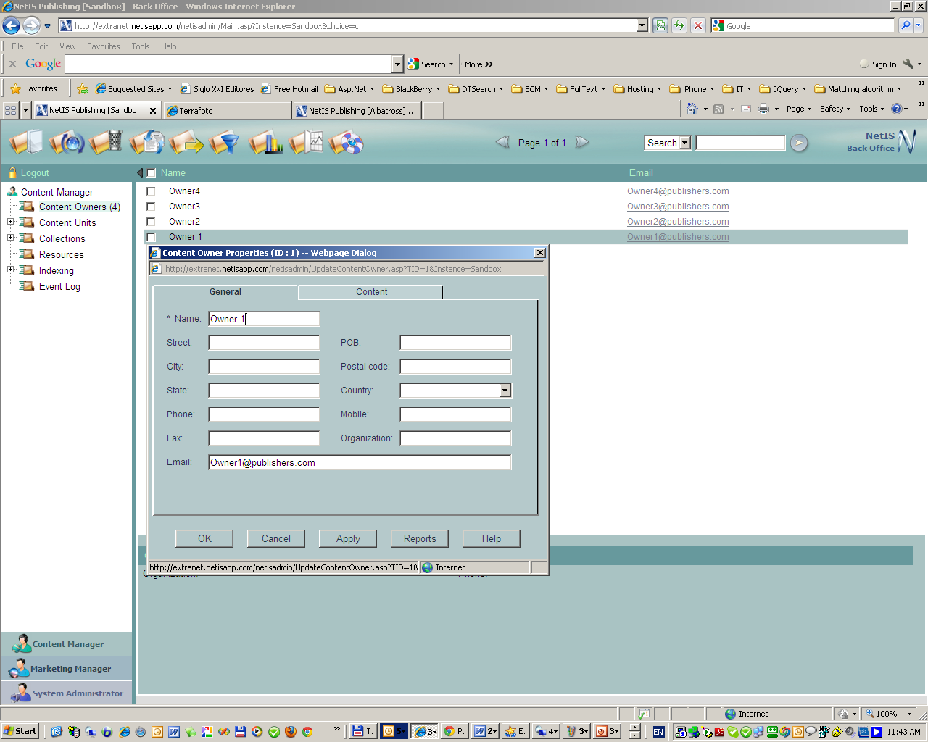
Auditing & Reporting
Online up-to-date Audit Information
Product/Customer Slicing
Customer Activities
Concurrent Usage Monitoring
Dashboard
Sales Statistics
And more…

Slide 14
Thanks for your attention！
NetIS™
A real ecommerce platform for the secure distribution and sales of content

