Slide 1
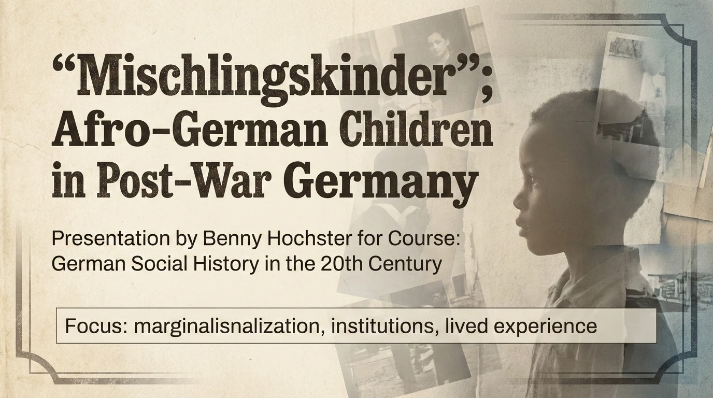
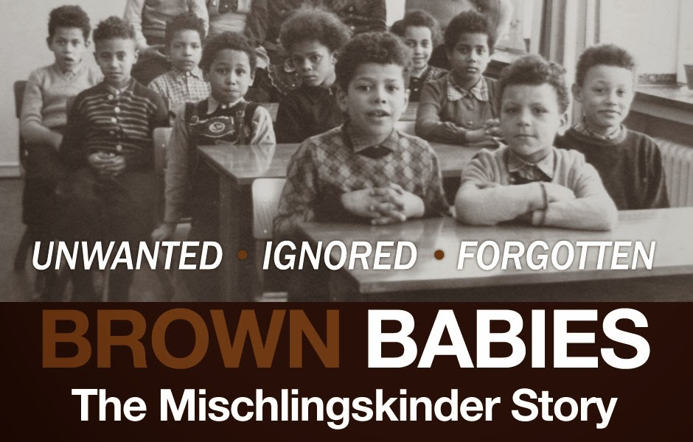
“Mischlingskinder” Afro‑German Children in Post‑War Germany
Focus: marginalization, institutions, lived experience
Notes:
Use 'Mischlingskinder' as a historical term; prefer 'Afro-German occupation children/Besatzungskinder'.
Core sources: Fehrenbach (2005); Lemke Muniz de Faria (2003).

Slide 2
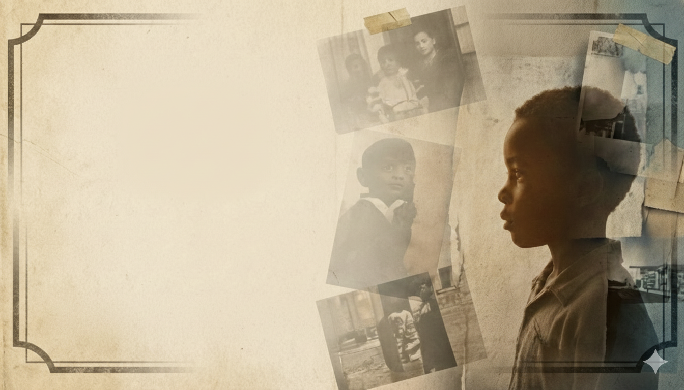
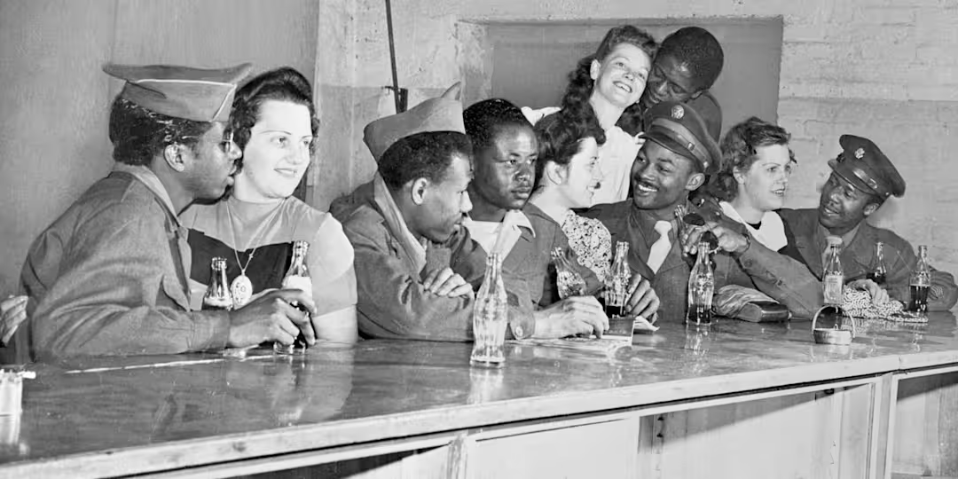
Who were the Mischlingskinder?
Born to German mothers and Black Allied soldiers (African American GIs)
Concentrated in occupation zones of West Germany.
Quickly Became a public “problem category” (not just private families)
Notes:
Keep numbers cautious; emphasize visibility and symbolism.
Fehrenbach (2005).

Slide 3
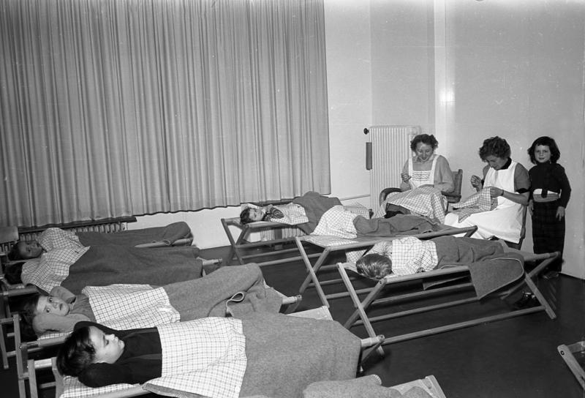
How marginalization worked (social history lens)
Stigma aimed at mothers: “fraternization” moralizing, shame, and social exclusion
Racism in neighborhoods: staring, slurs, isolation
School experiences: bullying, teacher non‑interventionand lowered expectations
Language (often of “care”): reinforced marginalization - “a problem to manage”, “not belonging” “need to normalize”
Notes:
One concrete example verbally; no long quotes.

Slide 4
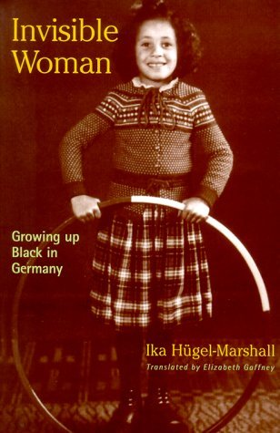

Lived Experience - Ika Hügel‑Marshall: “double stigma”
“Besatzungskind” born “out of wedlock”
Childhood racism social invisibility
Later: identity search Afro‑German activism
Ika Hügel‑Marshall (born 1947)
Notes:
Stress how bureaucracy can reproduce exclusion.
Fehrenbach (2005); postwar education/welfare debate scholarship.

Slide 5
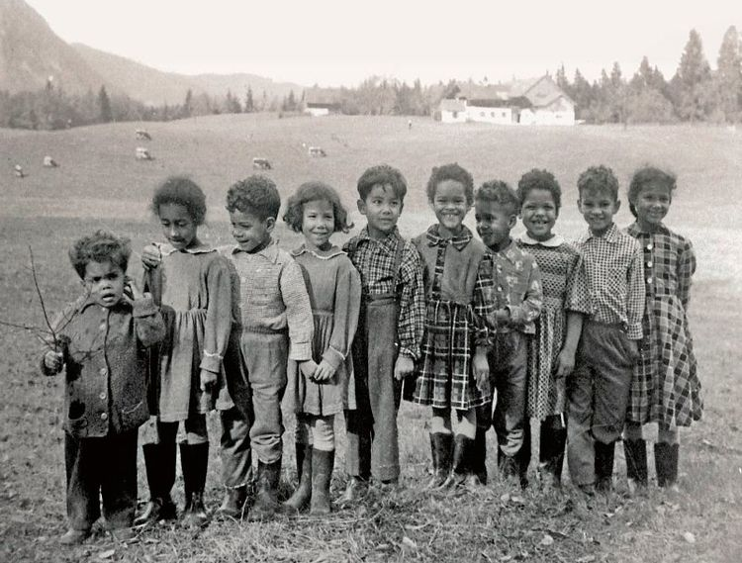
Separation as “care”: Kinderheime and adoption
Debate frame: “Germany can’t accept them” → remove them
Solutions: Children’s homes or transatlantic adoption (esp. to Black U.S. families)
Humanitarian rhetoric coexisted with the desire to remove visible “Blackness”
Aftermath: Family separation and decades‑later identity searches
Notes:
Memoir provides texture of everyday racism and institutional encounters.
Invisible Woman (English editions 2001/2002; annotated 2008).

Slide 6
Lived experience: Adoption and Identity Search
“Brown Babies” / adoptee stories
Being told (explicitly or implicitly): “you don’t belong here”
Long identity searches: parents, origins, language, country
Documentary and interviews put voices to the archive
Notes:
Scholarly anchor: Lemke Muniz de Faria (Callaloo, 2003) on U.S. adoption plans (1950–1955).

Slide 7
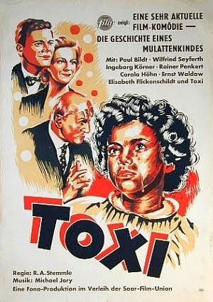
Representation: Toxi (1952)
First major West German film to depict a Black “occupation child”
Sympathy, but belonging is conditional (“tolerated” if non‑threatening)
Often centers white moral lesson more than the child’s autonomy
Notes:
Use as cultural window; keep it short.
DEFA Film Library entry; basic film facts.

Slide 8

Conclusion
Marginalization was multi‑layered: stigma, institutions and daily racism
“Care” often meant classification and removal (homes/adoption)
Key takeaway: postwar democracy still negotiated “German‑ness” through race
Notes:
Close with shift in voice and politics of belonging.
ISD (1985); Farbe bekennen (1986).

Slide 9
Selected sources
Academic
Personal / first‑person
Heide Fehrenbach, Race after Hitler (Princeton UP, 2005)
Yara‑Colette Lemke Muniz de Faria, “Germany’s ‘Brown Babies’…” Callaloo 26:2 (2003)
Post‑1945 welfare/education debates on Besatzungskinder (selected articles/chapters)
Work on Toxi and post‑Nazi race discourse (film + cultural history)
Ika Hügel‑Marshall, Invisible Woman: Growing Up Black in Germany (memoir)
Brown Babies: The Mischlingskinder Story (documentary; interviews)
Farbe bekennen / Showing Our Colors (1986): testimonies and movement text
Notes:
If the instructor wants strict formatting: convert to Chicago or MLA in a handout.

