Slide 1
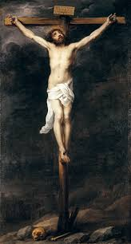
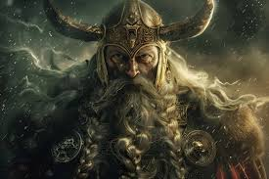
From Christ to Odin
The Mythic Undercurrent of German Nationalism (1800–1933)
Myth, Religion, and the Sacralization of Volk and Heimat
Presentation for the course German Nationalism
Presented by Benny Hochster

Slide 2
The Religious Vacuum of Unification
• Germany lacked a single confessional identity
• Catholic–Protestant division blocked symbolic unity
• Nationalism required a new unifying myth

Slide 3
Why Christianity Appeared Problematic
• Universalism conflicted with ethnic particularism
• Roman and Judeo-Christian origins framed as ‘foreign’
• Confessional conflict weakened cohesion

Slide 4
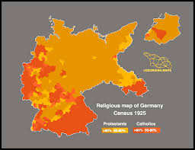
Kulturkampf (1870s)
• State–Church conflict politicized religion
• Catholic loyalty to Rome framed as anti-national
• Religion became a boundary of belonging

Slide 5
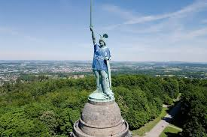
Anchor I: Hermann / Arminius
• Pre-Christian myth of resistance to Rome
• Romantic nationalism reimagined Hermann
• German identity before Christianity

Slide 6
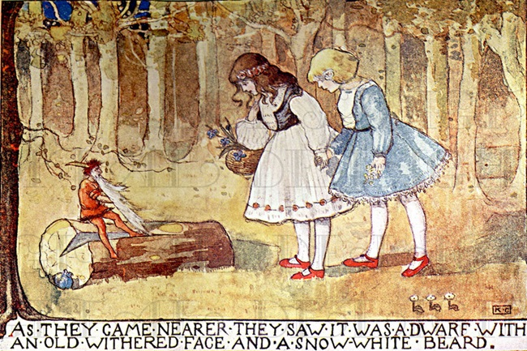
Anchor II: Romantic Myth Recovery
• Folklore treated as Volkskultur
• Jacob Grimm reconstructs Germanic antiquity
• Myth supplies historical depth

Slide 7

Anchor III: Wagner & Bayreuth
• Germanic myth becomes national culture
• Bayreuth as ritualized pilgrimage
• Art supplies emotion and destiny

Slide 8
Anchor IV: The Völkisch Turn
• Myth becomes worldview
• Volk, Blut, Boden, Heimat sacralized
• Nature religion replaces universalism

Slide 9
Institutionalization (1890–1918)
• Völkisch ideas enter organizations
• Langbehn and List systematize myth
• Symbolism moves toward politics

Slide 10
Christianity vs Paganism (1900–1933)
• Germanized Christianity vs neo-paganism
• Shared rejection of universalism
• Ethnic particularism as core

Slide 11
Conclusion
• Paganism did not replace Christianity
• It acted as a mythic undercurrent
• Nationalism became sacralized

Slide 12
Selected Bibliography
George L. Mosse – The Crisis of German Ideology
Helmut Walser Smith – German Nationalism and Religious Conflict
Uwe Puschner – Völkisch-Religious Movements
Stefanie von Schnurbein – Norse Revival
Nicholas Goodrick-Clarke – The Occult Roots of Nazism

