Slide 1


Slide 2
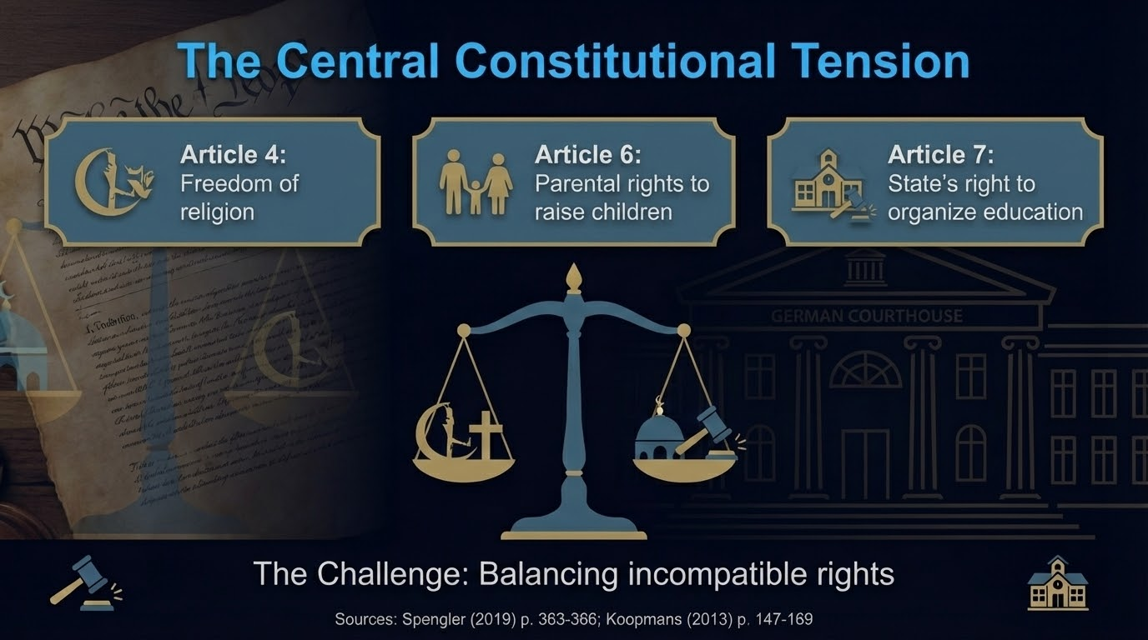

Slide 3
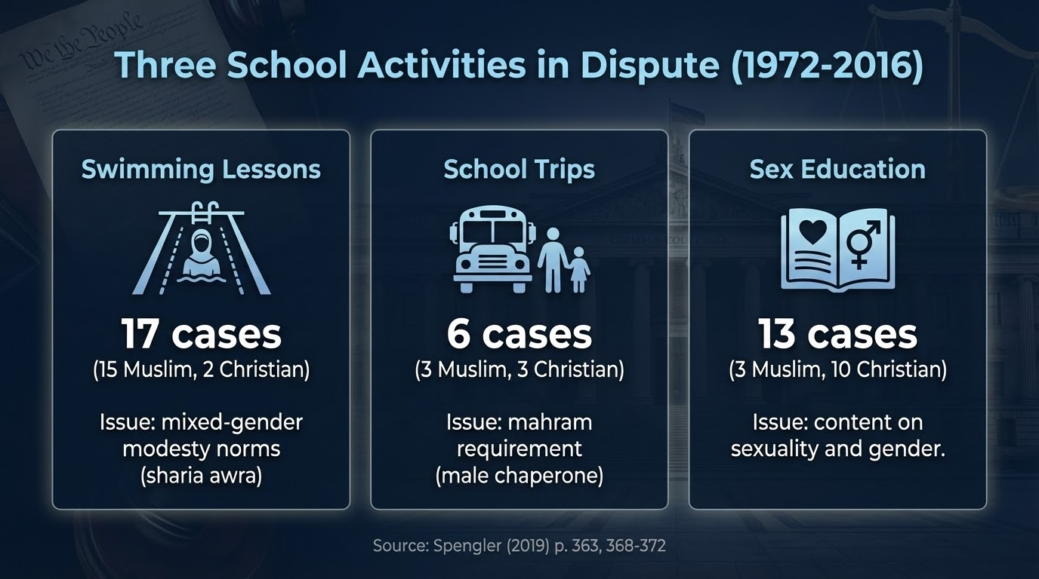

Slide 4
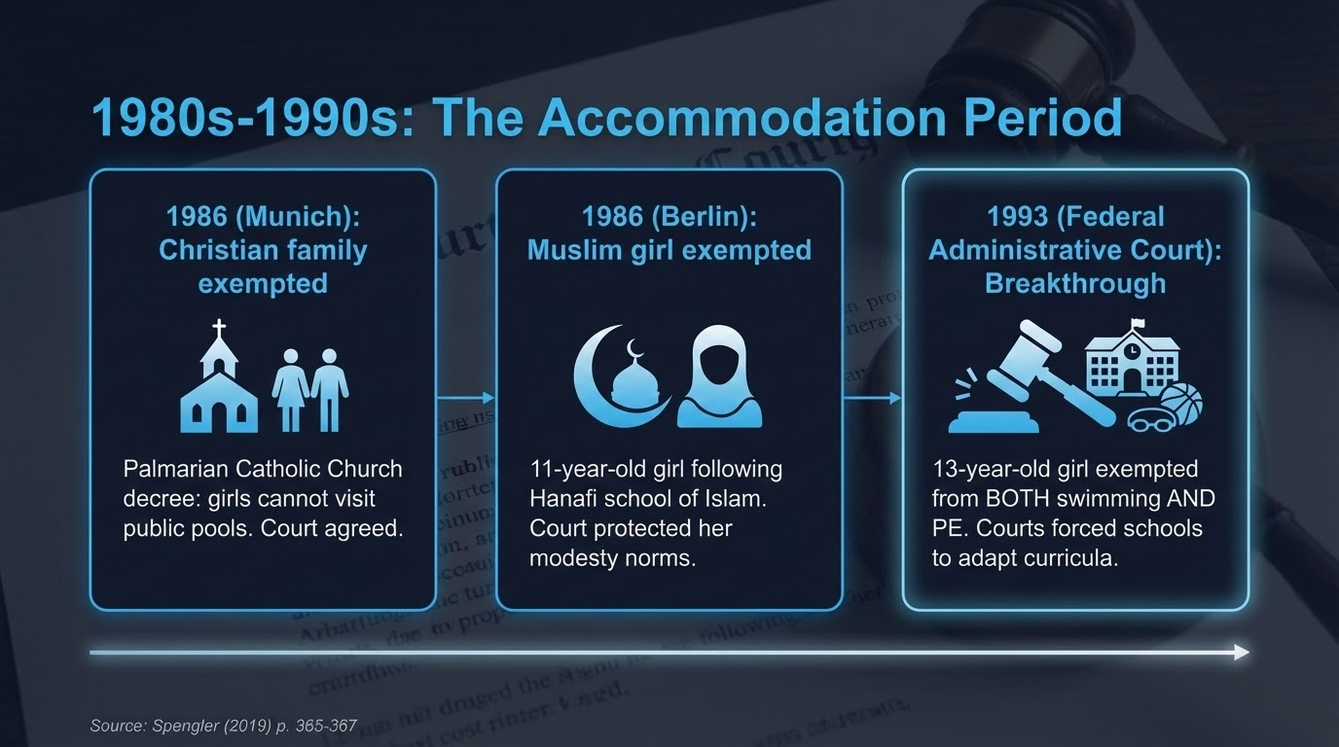

Slide 5
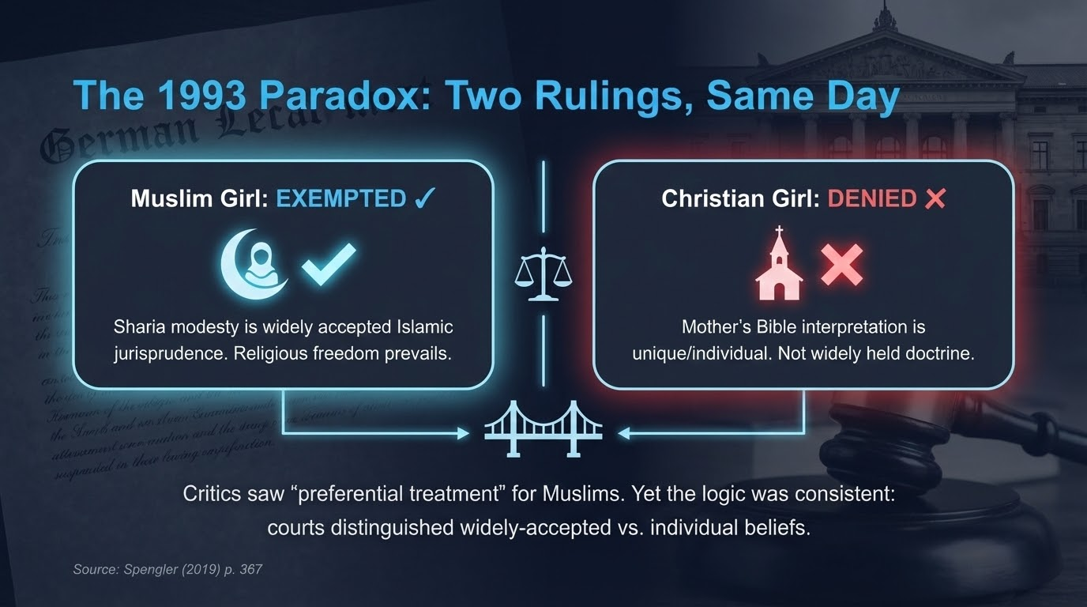

Slide 6
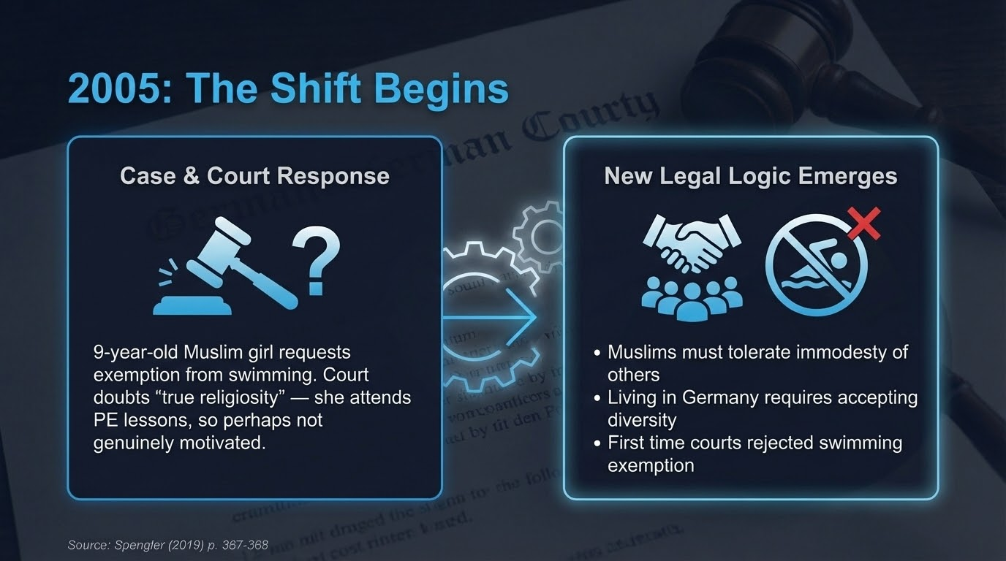

Slide 7
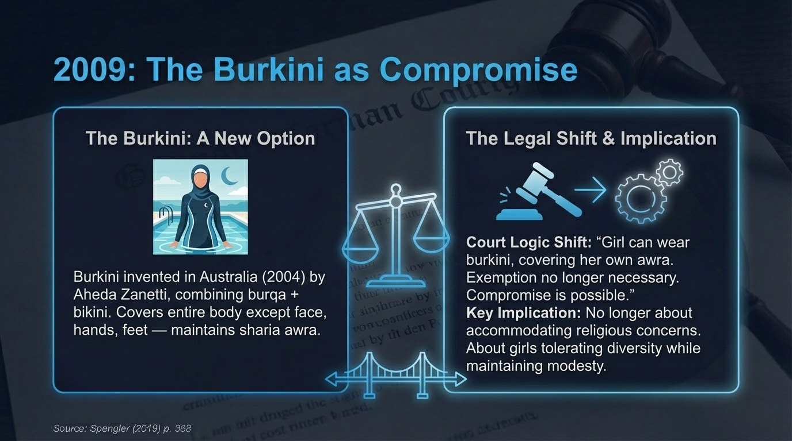

Slide 8
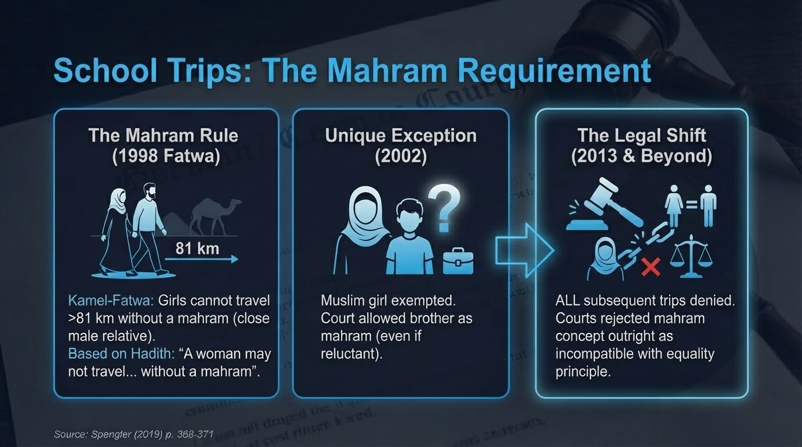

Slide 9
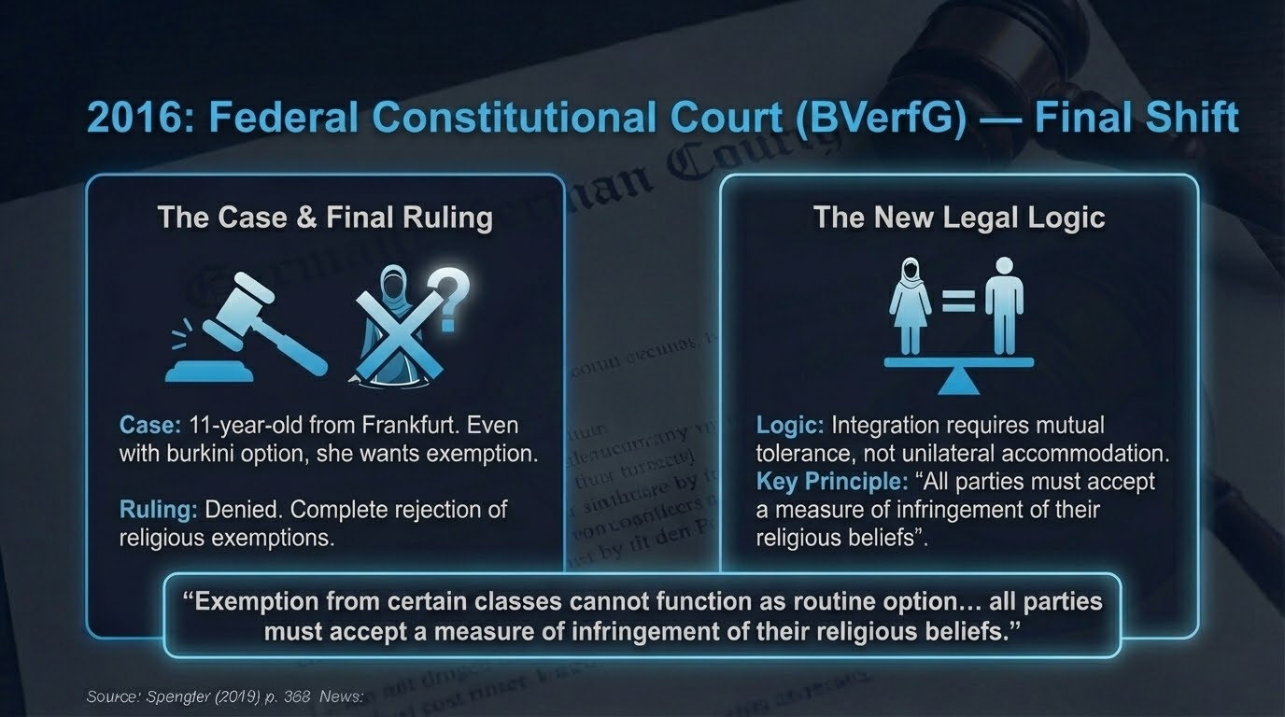

Slide 10


Slide 11
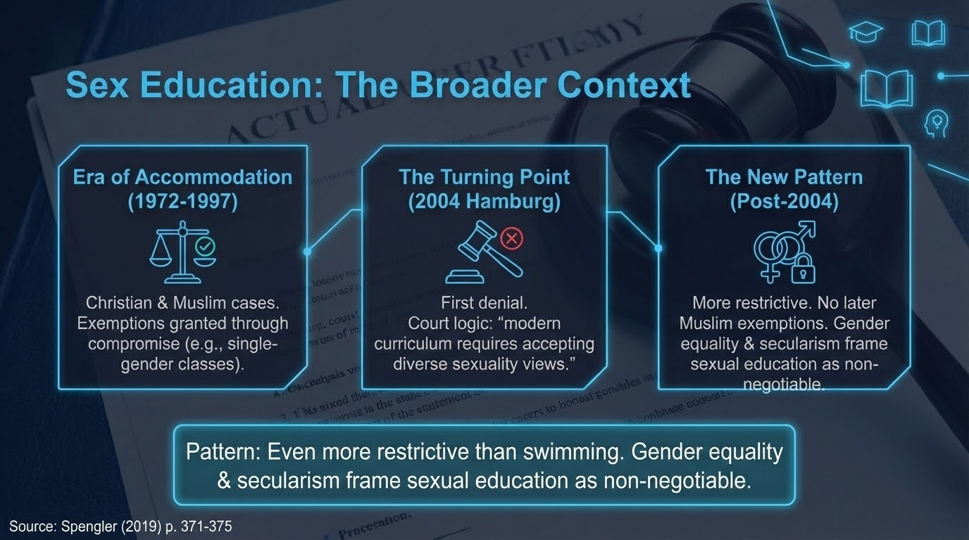

Slide 12
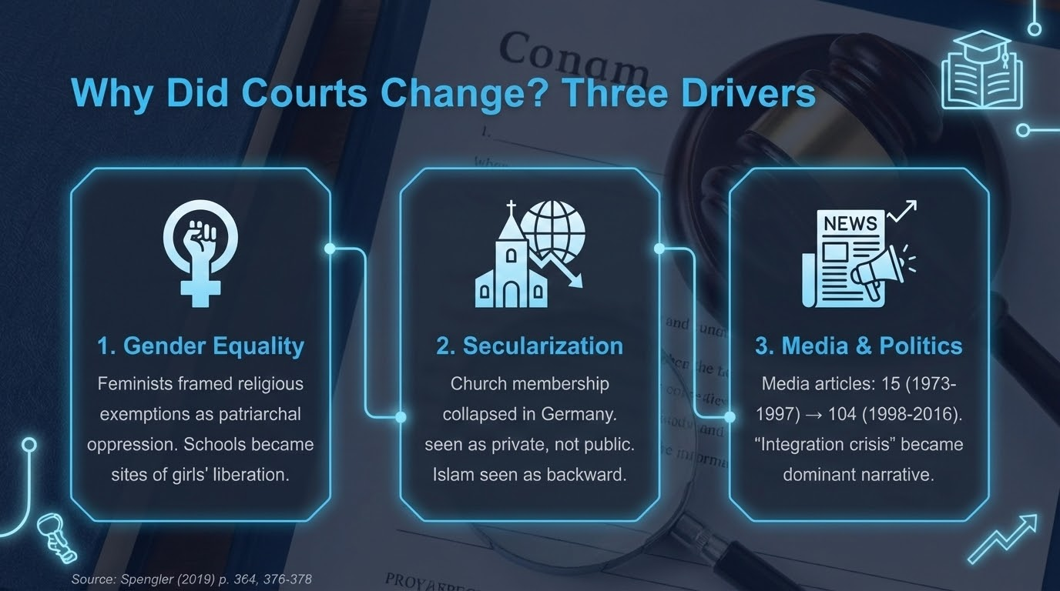

Slide 13
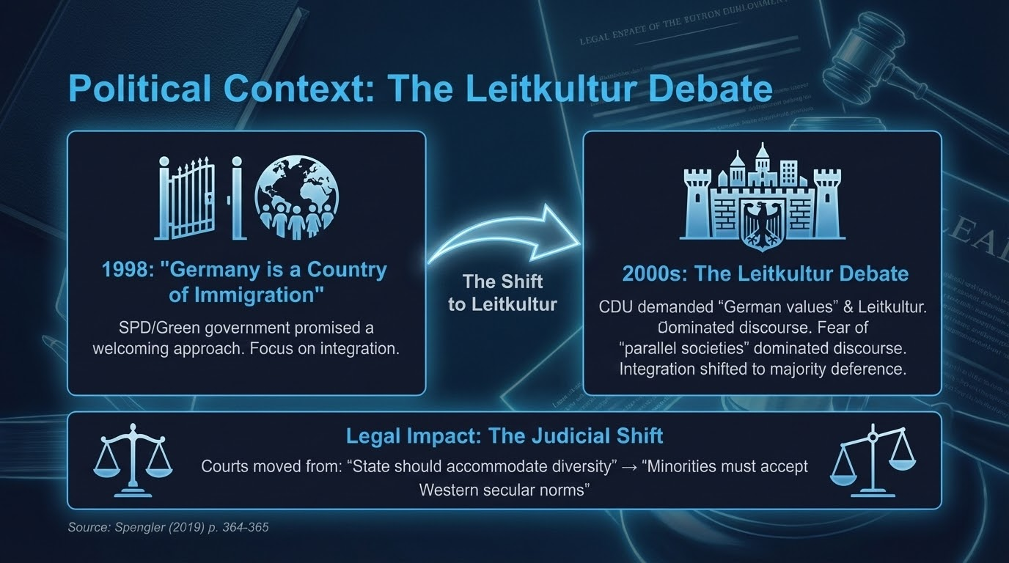

Slide 14
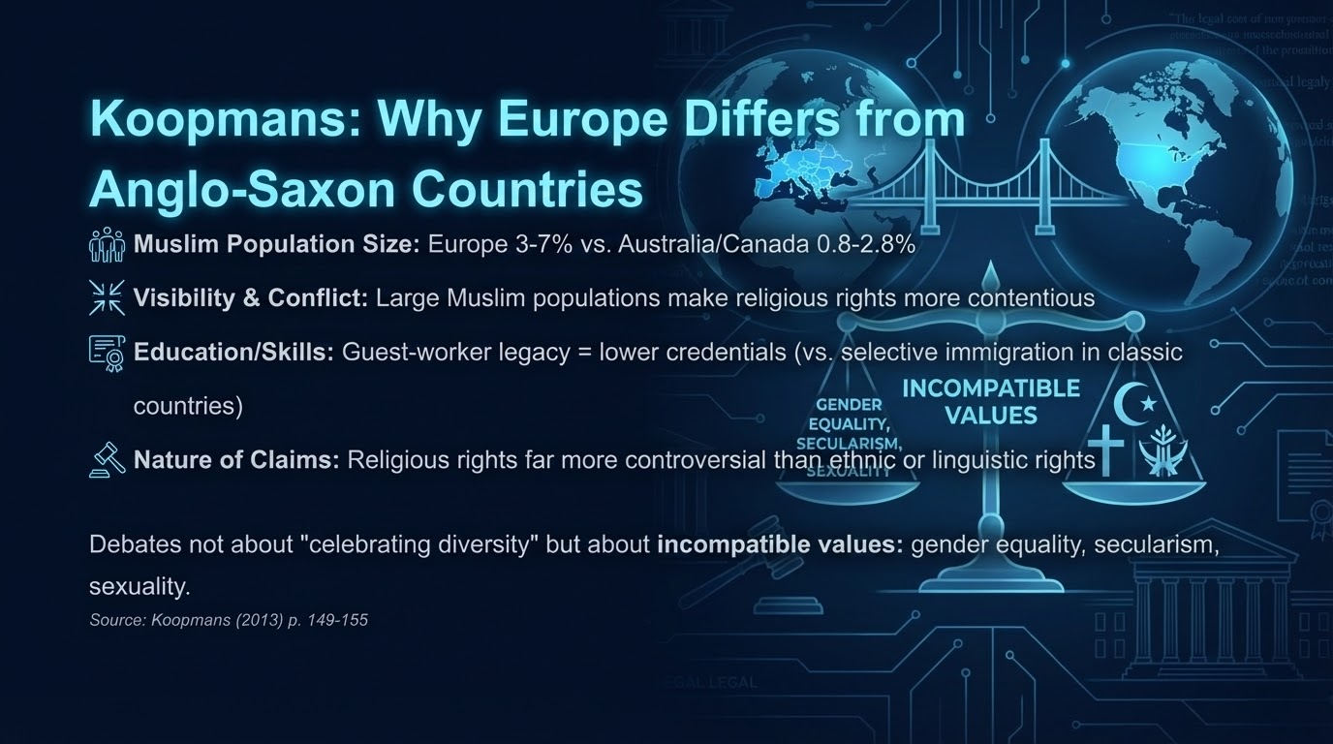

Slide 15
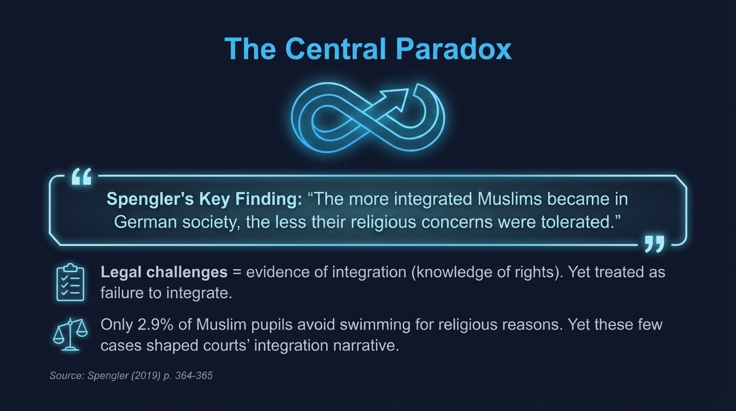

Slide 16
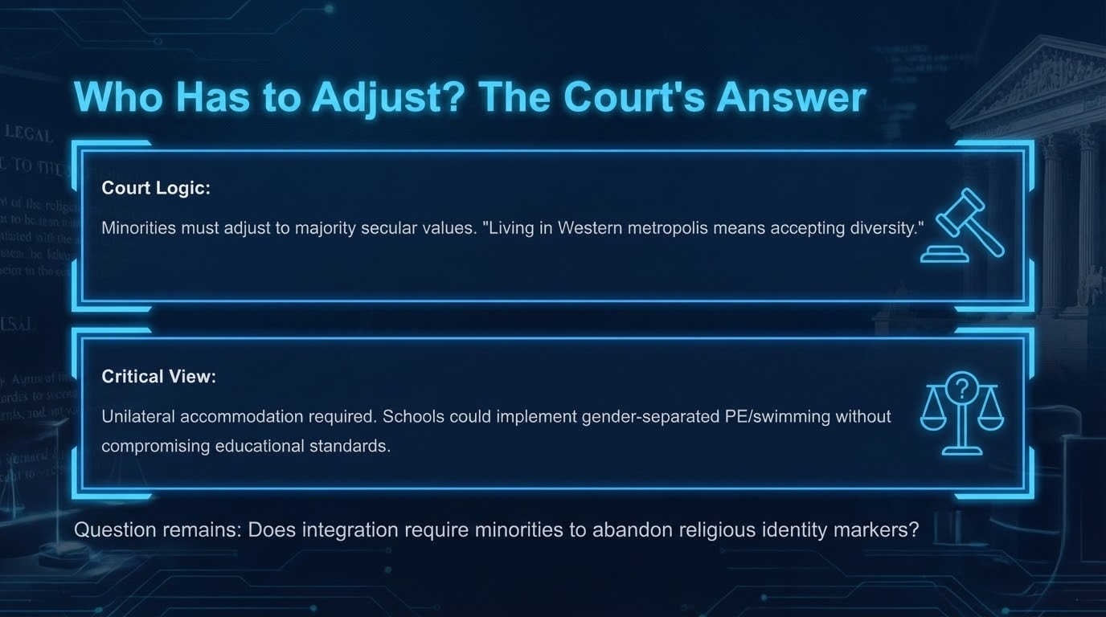
Who Has to Adjust? The Court's Answer
Court Logic:
Minorities must adjust to majority secular values. "Living in Western metropolis means accepting diversity."
Critical View:
Unilateral accommodation required. Schools could implement gender-separated PE/swimming without compromising educational standards.
Question remains: Does integration require minorities to abandon religious identity markers?

Slide 17


Slide 18
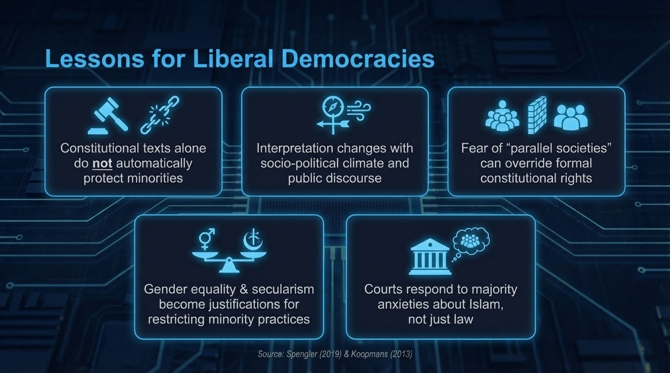

Slide 19
2018 & Beyond: The Burkini Debate Continues
June 2018: German school buys 20 burkinis. 15 Muslim girls now participate in swimming.
Family Minister Franziska Giffey (SPD): "Most important is children's well-being. Everyone must learn to swim."
CDU Opposition: Burkini "cements discriminatory understanding of women" in place where they learn equality.
Debate continues: Integration through inclusion or through enforcement of secular norms?
Source: BBC (Jun 24, 2018). See: |

Slide 20
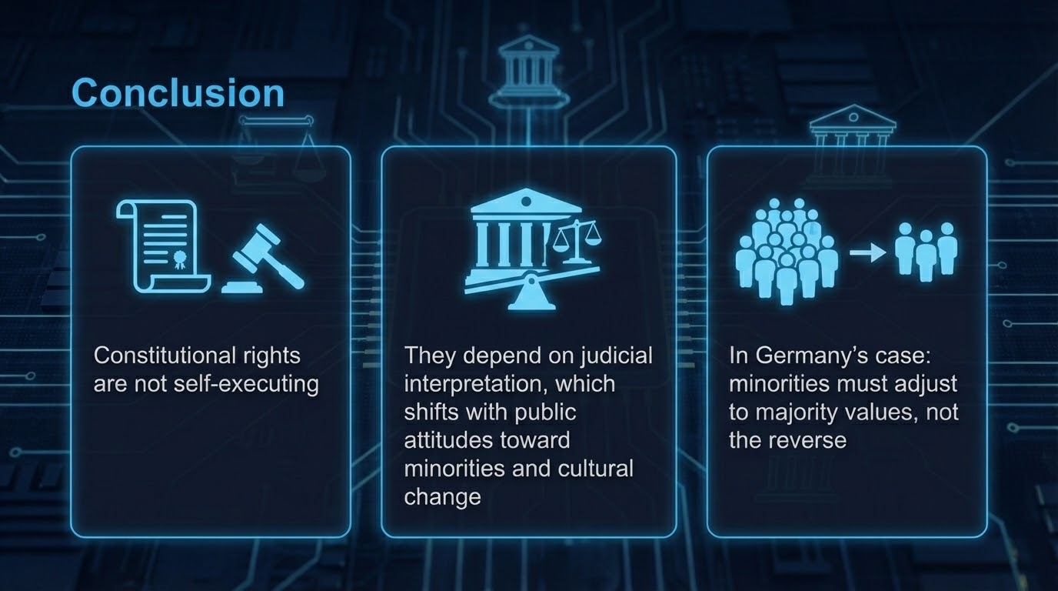

Slide 21
